Slide 1
Agenda
Reporting Guidelines
Reporting Ecosystem
Methodology
Oracle Reporting Tools
Dispositioning Framework & Rationalization
Reporting Requirement Management
Current State & High-Level Timeline
Known Risks & Mitigation
Appendix

Slide 2

Enterprise Architecture Reporting Guidelines
Leverage Out-of-box (OOTB) / native application reporting capabilities for business area specific operational reporting and compliance reporting, provided:
Licensing requirements are met for users
Data Security requirements are met for reporting
Data requirements are met – real-time reporting needs, enterprise architecture approved data integration required for completeness, historical data availability
Engage Transcend for development complex management reporting & self-service analytics.
Enterprise-wide management reporting that require data from multiple systems
Management deep-dive reports that require historical trend analysis with complex transformations
Building single source of business representation of data to support with standards for front-end application development
Reporting within a specific business area developed by the business, analytics teams
For prototyping, analytics discovery by combining production data with a new data source to evaluate business value
Note: Data ingestion into Transcend from source applications, including Oracle Cloud, is prioritized based on reporting and analytics needs.

Slide 3
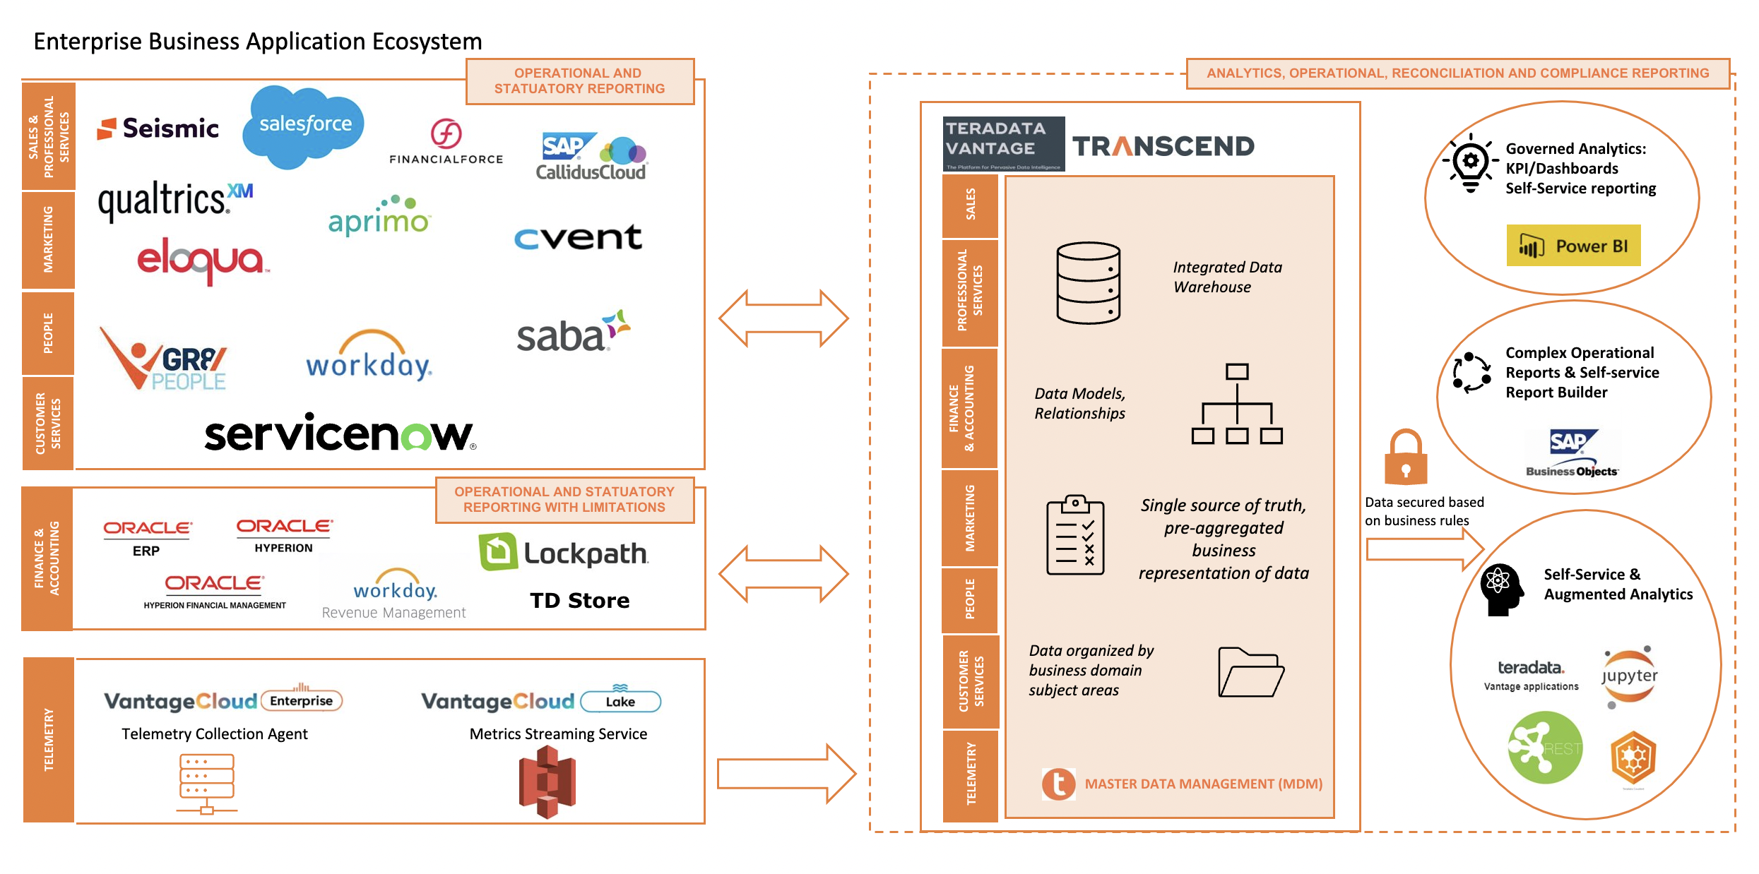
Reporting Ecosystem : Current State

Slide 4
Transcend Reporting Patterns: Current State
Company Level Reporting
Enterprise Dashboards
Cross-domain Analytics
Self-service Analytics
Adhoc Reporting
Data Reconciliation between systems
Operational: Business Process & Compliance Reporting
Accounting business process
Month-end accounting close process
Operational reports
Prototyping of Analytics
Collaborative Analysis
Operational: Reconciliation Reporting
Audit reports
Data Governance reports
Analytical
Challenge: Limited reporting capabilities on Oracle on-prem ERP solution to support operational and compliance needs
Transactional
Notes:
Operational reports are formal documents or reports which provide the most granular level detail for business transactions and events.

Slide 5
Transcend Reporting Patterns: Future State
Analytics / Company Level Reporting
Enterprise Dashboards
Cross-domain analytics
Self-service Analytics
Adhoc Reporting
Data Reconciliation between systems
Operational: Business Process & Compliance Reporting
Accounting business process
Month-end accounting close process
Operational reports
Prototyping of Analytics
Collaborative Analysis
Operational: Reconciliation Reporting
Advanced Analytics
KPI Dashboards
Data Governance reports
Audit reports
Increased focus to derive insights
Analytical
Transactional
Exception Based
Notes:
Operational reports are formal documents or reports which provide the most granular level detail for business transactions and events.

Slide 6
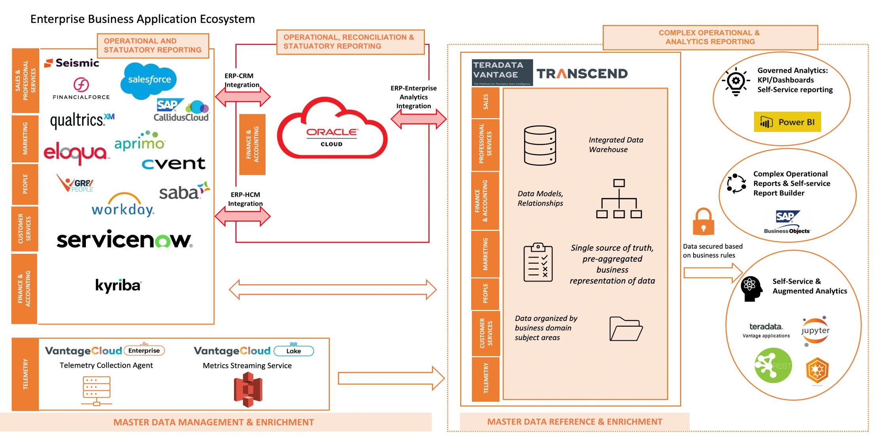
Reporting Ecosystem : Future State (Work-in-progress)

Slide 7












Reporting Ecosystem : Master Data Management (MDM)
Federated MDM Architecture
M
MDM Catalog
Analytics Reports
Product
Install Base
Chart of Accounts
Enterprise Data Structure
Tax/Fin Customer Attributes
Location
M
M
Customer Account
Contact
M
M
M
M
Reporting leveraging MDM
M
HR Data
People Data
Component Install Base
Service Attributes - Customer
M
MDM Tables
MDM Dictionary
MDM Glossary
Metrics
M = Master App
Key Takeaways:
Self-service data analytics
1
2
3
Key architectural principle: Master Data, unless by exception, will be integrated to Transcend
Holistic Master Data Management Views will be available for federated data objects in Transcend
Fitting into architectural concept: a Master Data Catalog, Data Dictionaries, Glossaries and Metrics will be available for viewing or reporting master data, regardless of source

Slide 8
Reporting Methodology
The reporting methodology for Optimus Prime Program is based on the approach outlined below:
We are here
Start
1
2
3
4
5
Rationalization
Define the reporting sources and requirements and identify the tools that will be necessary.
Define the current reporting landscape
Build the reporting needs
Perform Fit-Gap
Review Fit-Gap
Assess requirements to best fit the source system/ reporting tool and prioritize
Template_Link
9
8
7
6
Development
Design, build and test the reports according to the business requirements provided.
Validate the reports based on test cases
Develop the reports based on requirement
Configure role level security to provide read/write access to users
Map business needs to reporting design
10
11
Delivery
Schedule reports when necessary and prepare users for execution and consumption.
Finish
Schedule reports using reporting tools
Train users to enable them to execute and consume reports
XYZ And Deloitte Ownership
XYZ
Dependent on Tool finalized ownership will be decided

Slide 9

Oracle Reporting Tools
BI Publisher Enables highly formatted operational reports with advanced features such as bursting and scheduling
Financial Reporting Studio/Management Reporting Enables browser-based financials reports for management reporting with real-time drill down capabilities
Smart View Enables excel-based slice-and-dice of data for easy and quick ad-hoc financial reporting
Narrative Reporting (NR)
Enables accessing data from Oracle EPM and Cloud Financials to bring in Charts and Grids with textual narrative in a single report
Oracle Transactional Business Intelligence (OTBI) Enables business users to do self-service reporting on real-time transactional data
** Slide 42 has the links to the demo recordings for these tools

Slide 10

Salesforce Integration Tool and Strategy – Being Evaluated
Salesforce connect is being evaluated to support the data integration and reporting out of salesforce
Salesforce Connect
Salesforce Report Types:
Transcend GTM Reports – Not in scope for Phase 1B
Ad-hoc Salesforce Reports – In Scope for Phase 1B
Order Header
Order Line
Invoice Header
Invoice Line
Subscription Header
Subscription Line
6 External Objects to be configured in Salesforce
REQ
Ability to configure external object data access in Salesforce to Oracle Cloud ERP via Salesforce Connect (ODATA) integration to Oracle.
APPROACH
Utilize Salesforce connect to integrate with Oracle Cloud | Deloitte
Configure External Objects on the Salesforce platform that will connect to specific Oracle ERP tables | Deloitte
Configure additional Salesforce External Objects to enable data from additional Oracle ERP tables to be displayed within Salesforce | XYZ
Configure Custom Report Types in Salesforce that join Oracle ERP data to Salesforce data | XYZ
Build any new Salesforce reports for GTM users that combines and displays transaction-related data from Oracle that is related to Salesforce Accounts, Quotes, and Opportunities | XYZ

Slide 11
Reporting Tools Rationalization
The flowchart below illustrates the typical rationalization steps that will be followed to identify the best-fit Reporting Tool for the requirements. Fit-Gap analysis will be performed to leverage standard (Out of the Box) Reports, where available, to meet the requirements.
Notes:
If Oracle Cloud is not target state, Opportunity to leverage source systems and not disposition everything has Transcend

Slide 12
Oracle Decision Data Point Matrix
 | OTBI | BI Publisher | FRS/Management Reporting | SmartView | Narrative Reporting
Real Time | Yes | Yes | Partial | Partial | Partial
Dashboard Support | Yes | Yes | No | No | No
Ad-hoc Reporting | Yes | Yes | Yes | Yes | Yes
Data Volume | Low | Medium to High | High | High | High
Data Limit | 75K CSV /25K for excel | 300 MB (online) * 500 MB (scheduled) * 15 MB (mail attachment) | 1M Cells | 1M Cells | 30 or less for count 5MB for size
Typical Usage | Ad-Hoc, Dashboards, Headcounts, Drill Downs | Data Listings, Forms, Audits | P&L, Balance Sheet, Account Balance | Drill down of account balance | Cross GL vs EPM, within different EPM modules
* Size of XML output data. Configurable.

Slide 13
Tools Rationalization (Transcend)
The flowchart below illustrates the typical rationalization steps that will be followed to identify the best-fit Reporting Tool for the requirements. Fit-Gap analysis will be performed to leverage standard (Out of the Box) Reports, where available, to meet the requirements.
Is this report for enterprise- wide use?
No
No
No
Is this an Operational Report?
No
Is this an audit
or compliance Report?
Start
Is Self-Service reporting possible?
Is this a Management
report?
No
Yes
Yes
Yes
Yes
Power BI Dashboard
Review the business case
and why can’t
application OOTB report?
Review the reporting pattern and recommend any other tool in the current ecosystem if PBI/BO cannot be used
Can Power BI handle?
Can Power BI handle?
Yes
No
Yes
Approved
Rejected
Power BI Datasets
Business Objects Universe
Power BI Dashboard
Power BI Paginated Reports
Send to application reporting review and work with business team
Notes:
Self-service
PowerBI and Business Objects – Pre-canned
Change Management – Assess/evaluate needs for PowerBI usage training and enablement

Slide 14






Report Dispositioning – Next Steps
Sandeep / Arthi
1.2: Reporting user stories from workshops
Add User stories to Reporting list
Phase prioritization
Initial FIT/GAP
Clarification question for SMES
Update priority, and other reporting template columns
High level reporting requirement
Mapping to target reporting tool/systems
1.1: Reporting Requirement from Template
2.1: Initial analysis by Deloitte Leads
3: Review with Reporting SMEs
4: Reporting Tool rationalization for requirements
2.2: Initial analysis by Reporting Leads for Transcend Reports
5: Report prioritization
6: Reporting Deep Dives
(Sprint Cycle)
7: Lean Spec generation for custom Report
8.1: Reporting Development
Sprint assignment
Roles
8.2: Report Configuration for OOB Reports
Deloitte Workstream
Lead
Functional Leads
SMEs
Xyz Reporting Leads
XYZ ITLeads
Checkpoints
PMO, GBPO

Slide 15
Reporting Activities – Prioritization, Dependencies etc.,
Sandeep
Phase Assignment – As part of the report dispositioning, reports will be mapped to OP phases(1A/1B/2) in alignment with the overall program implementation plan
Prioritization – After the report disposition steps are completed, with consensus with the workstream/ Reporting team, a list of custom reports that are needed to be in the Future State will be finalized. team is expected to share the priority of the reports for development based on Business criticality and other factors
Dependencies – During the disposition phase and the deep dive discussions with workstreams regarding reporting requirements, reporting dependencies (example: if a report cuts across more than 1 workstream or more than 1 application) will be identified and the corresponding workstreams/applications will be assigned ownership
Build the Backlog – Reporting backlog for development will be built based on the phase-wise assignment of the report and criticality defined by team. These will be later mapped to development sprints of the phase for report development
Sprint Assignment – Backlog reports will be assigned to sprints and all the report level activities like development, Technical Unit Testing, Functional Unit Testing etc., and report delivery will be tracked accordingly
Notes:
Add Data Steward? Master Data Management?

Slide 16
Workstream Reporting SMEs
Sandeep / Sankar
List of Reporting SMEs identified from each vertical workstreams.
Contacts
Workstream | Sponsor | GBPO | Functional Lead | IT Lead | Reporting SME
Lead to Quote | Evan Randall | Will Wu | Jim Maher, Szymon Dziocha | Danny Pulache | Steven Gifford, Justin Evans
Order to Fulfill | Charles Smotherman | Steven Deluca | Susan Stalcup, Derrell White | Chris Marsh, Naveen Jain | Susan Stalcup
Issue to Resolution | Alex Console | Ann Grimes | Kirk Balingit | Senthil Kesavan | Aznan Hasan Khan, Kevin M Philips
Invoice to Cash | Charles Smotherman | Steven Deluca | Susan Stalcup, Helen Freeman | Dermot Doyle | Susan Stalcup
Record to Report | Charles Smotherman | Eric Leis | Kelly Burns | Anthony Coleman | Kelly Burns
Plan to Perform | Rich Shane | Allison Ross | Patrick Nigro | Anthony Coleman | Patrick Nigro
Source to Pay | Charles Smotherman, Erica Hausheer | Amanda Patterson | Elliott Ulmer, Linda Persina | Naveen Jain | Vinith Kumar (Procurement), Nancy Ma (Payables)
Tax & Treasury | Charles Smotherman | Laura Jividen | Doug Bryan, Celeste Tam, Brian Pierson | Anthony Coleman | Doug Bryan, Celeste Tam, David Chrisman (Treasury)
Prof. Services Projects | Rich Shane | Jim Lewis | Patrick Berger | Atieh Akbar, Ellie Bluestein | Patrick Berger

Slide 17
Responsibility Matrix (Oracle Cloud Reporting Ownership)
Sandeep
This Responsible, Approver, Consulted, and Informed (RACI) matrix is built specific to the steps involved in building the reports identified as part of implementation project.
RACI Matrix
Tasks | Functional Leads | GBPO | Reporting Team | Tech Team | Deloitte Functional Team | Deloitte Tech Team
Reports Business Requirements | R/A | R/A | C | I | C | I
Functional Design & Configuration | C/A | C/A | I | C | R | C
Technical Design & Build | C | C | C | C/A | C | R
Code Migration | I | I | I | C/A | I | R
Unit Testing—Technical | I | I | I | C/A | C | R
Unit Testing—Functional | I | I | I | C | R/A | C
Integration Testing | I | I | I | C | R/A | C
User Acceptance Testing | R/A | R/A | C | C | C | C
Cutover Tasks | C | C | R | R | C | R

Slide 18
Responsibility Matrix (Salesforce & Oracle Cloud ERP Integration Ownership)
Sandeep
This Responsible, Approver, Consulted, and Informed (RACI) matrix is built specific to the steps involved in building the reports identified as part of implementation project.
RACI Matrix
Tasks | Functional Leads | GBPO | Reporting Team | Tech Team | Deloitte Functional Team | Deloitte Tech Team
Reports Business Requirements | R/A | R/A | C | I | C | I
Functional Design & Configuration | C/A | C/A | I | C | R | C
Technical Design & Build | C | C | C | C/A | C | R
Code Migration | I | I | I | C/A | I | R
Unit Testing—Technical | I | I | I | C/A | C | R
Unit Testing—Functional | I | I | I | C | R/A | C
Integration Testing | I | I | I | C | R/A | C
User Acceptance Testing | R/A | R/A | C | C | C | C
Cutover Tasks | C | C | R | R | C | R

Slide 19
Responsibility Matrix (Custom Transcend Reporting Ownership)
Sandeep
This Responsible, Approver, Consulted, and Informed (RACI) matrix is built specific to the steps involved in building the reports identified as part of implementation project.
RACI Matrix
Tasks | Functional Leads | GBPO | Reporting Team | Transcend Functional Team | Transcend Tech Team | Deloitte Functional Team | Deloitte Tech Team
Reports Business Requirements | R/A | R/A | C | C | I | I | I
Functional Design & Wireframe | C/A | C/A | I | R | C | I | I
Prototyping | C/A | C/A | I | R | R | I | I
Technical Design | C | C | C | C | R | R* | C
Data Ingestion | I | I | I | R/C | R | C | R#
Coding and Unit Testing | I | I | I | C | R | C | C
Functional Testing | I | I | I | R/A | C | C | C
Integration Testing | I | I | I | R/A | C | C | C
User Acceptance Testing | R/A | R/A | C | C | C | C | C
Data Security | A | A | C | R | R | C | C
Go Live | C | C | R | R | R | C | C
R* - Deloitte Functional team will work with for mapping details from Oracle cloud
R# - Deloitte Technical team will share the data extract as requested by Transcend for reporting

Slide 20
Responsibility Matrix (Other Boundary System Reporting Ownership) – IT or BI teams from business
Sandeep
This Responsible, Approver, Consulted, and Informed (RACI) matrix is built specific to the steps involved in building the reports identified as part of implementation project.
RACI Matrix
Tasks | Functional Leads | GBPO | Boundary System Application development Team | Deloitte Functional Team | Deloitte Tech Team
Reports Business Requirements | R/A | R/A | C | I | I
Functional Design & Configuration | C/A | C/A | R | I | I
Technical Design & Build | C | C | R | I | I
Code Migration | I | I | R | I | I
Unit Testing—Technical | I | I | R | I | I
Unit Testing—Functional | I | I | R | I | I
Integration Testing | I | I | R | I | I
User Acceptance Testing | R/A | R/A | R | I | I
Cutover Tasks | C | C | R | I | I

Slide 21




Oracle Reporting Security – BIP, OTBI and FRS
Sandeep
Reporting security roles provide the end-user functional privileges for reporting. Users will be assigned roles based on their job duties.
Report Descriptions
How is access controlled? *
Business
Intelligence
Publisher
Used to create highly formatted transactional reports (i.e., check print reports)
SaaS
Transactional Data
Data Security
Reporting Roles
Oracle
Transactional
Business
Intelligence (OTBI)
OTBI is used for ad hoc reporting on real time transactional data
Available only through cloud financials.
Folder Security
Transactional Duties
Financial
Reporting
Studio (FRS)
FRS reports are primarily for management reporting
Available only through cloud financials.
Balances
Subject Areas
The information displayed in an OTBI report is based on the end-user’s data security access. “What you see in the application screen is what you will see in the report”
21

Slide 22
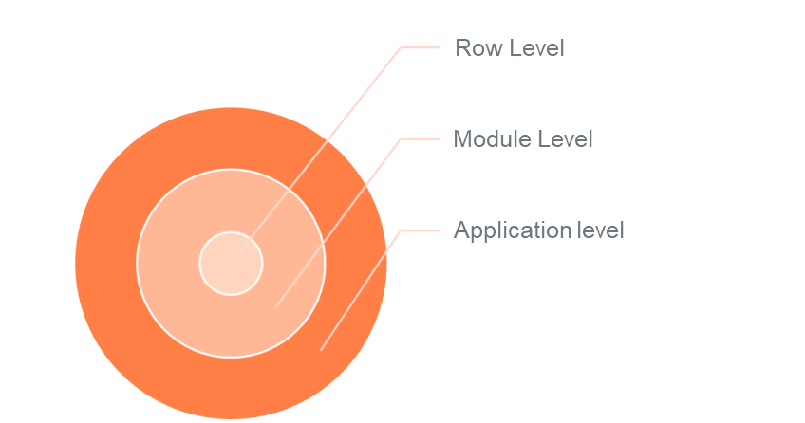
Transcend Report Data Security
Sankar
Application level: Access to a cross-domain dashboard or analytics application (PBI, Business Objects)
Module level: Access to a specific data subject area and/or application module (ARR or Revenue or Expense data in a dashboard)
Row level: Limit data available to view for that user (Row level security for regional hierarchy, planning organization and others)
Notes:
Opportunity to simplify, standardize & streamline implementation of security in Transcend
Leverage Deloitte's experience in ERP data security for analytics

Slide 23
Reporting Requirement - Current State
Sandeep
Workstream | No. of Reports
Record to Report | 166
Lead to Quote | 49
Invoice to Cash | 55
Order to Fulfill | 137
Procure to Pay | 9
Plan to Perform | 65
Source to Pay | 120
Issue to Resolution | 71
Tax & Treasury | 9
Prof. Services Projects | 17
TBD | 48

Slide 24
Reporting Workstream: Key Risk Mitigation
Arthi
AREA | RISK | Mitigation Plan | NOTES
Reporting scope of work not defined by phase, team | Global design exit for reporting workstream without completion of the initial dispositioning of requirements and building the user story backlog for reporting by phase, team. The number requests for reporting per workstream is high and the level of detail captured is insufficient to assess level of effort by phase | Initial prioritization and high level disposition of the requirements to be completed within 2 weeks of global design exit. Enlist GBPO and functional lead support to rationalize, consolidate and prioritize reporting requirements by phase. Please click here for process | Reporting work was deprioritized over the business process discussions and WTW preparation. Deloitte has a limited capacity reserved for custom reporting implementation for the entire OP program. Change Management to be exercised, based on PMO guidance.
Requirements management | The user stories for the functional workstreams are not complete and there may be reporting user stories captured after the initial dispositioning | Enlist GBPO and functional leads' support to review output of the dispositioning process to identify any key gaps in reporting requirements by phase. Dependencies across functional and other horizontal workstreams will be captured in detailed design. Finalize the data integration approach to ingest module level data into Transcend. Note: Data to be ingested into Transcend will be prioritized based on reporting and analytic needs | GBPO and functional leads have provided the initial list of reporting requirements. Exception based reporting user stories expected to be captured by functional leads during detailed design.
Oracle OOTB capability evaluation | Oracle OOTB reporting capabilities assessment not completed to confirm that NO GAPS exist to support the critical to finance business close processes. Any custom development by reporting teams will take time and may affect the overall timeline of the subsequent phases of the program | User stories for critical to finance business close processes are captured and will be prioritized during the dispositioning process. Oracle custom reports to be evaluated to fit any gaps identified. Discussions to be planned with GBPOs/functional leads to evaluate process changes before investing in custom reports Only exception based complex operational reporting (Ex: data from multiple systems) to be prioritized for Transcend

Slide 25


Report Dispositioning – Steps and subsequent activities
DRAFT
Sandeep
M3 | M4 | M5 | M6 | M7 | M8 | M9 | M10 | M11 | M12 | M13 | M14 | M15
Dec | Jan | Feb | Mar | Apr | May | Jun | Jul | Aug | Sep | Oct | Nov | Dec
Gather the reporting requirement list from
Initial dispositioning/analysis
Deep dive sessions for 1 Reports
Prioritization into phases 1A,1B and 2
Prioritization within sprint for 1A
Lean Spec generation
Reporting Timeline
Development Sprint – 1A
INT1 – 1A
UAT – 1A
Phase 1a
ERP Go Live
Phase 1a
EPM Go Live
Report Build
TUT and FUT
Development Sprint – 1B
UAT – 1B
Solution Lifecycle Stages
Imagine
Deliver
Run

Slide 26
Reporting Guiding principles
Brahmendra
Data Privacy
Report Category
Report Access
Data Volume
Report Format
Level of Reporting
The reporting solution is driven by a set of guiding principles that help align the factors involved in the reporting implementation methodology
Customer data
Internal data
Public data
High Volume
Low Volume
Batch extracts
HTML
Excel
PDF
Dashboard
Management
Transactional
Period Close
Analytical
Business Group
Legal Entity
Business Unit
Business Functions
Power Users Business Users
Principle | Benefits
Single source of truth | Enables true performance measurement and metrics usage across the organization Provides factual understanding and confidence in reporting
Information consistency | Drives commonality and consistency in decision-making across disparate functions and levels of the organization
Rationalized toolsets | Enforces standards to enable reliability and rapid development Limited toolsets reduce training effort and promotes transferability
Clearly defined access | Provides users with appropriate view of enterprise information
Minimal custom reports | Reduces maintenance efforts and eases impact on upgrade initiatives Leverage application provided Out-of-box reports, custom reports are a cost to the company

Slide 27

BI Publisher Reports
Why This Tool?
How Does It Work?
Additional Information
Flexibility to write SQL queries or tune performance; remove dependencies with Oracle for delivering OTBI attributes
Picture Perfect Reporting
Allow multiple output formats like pdf, html, rtf, excel
Support for Bursting options to multiple destinations
High volume data reports can be developed
Supports calculations though SQL queries
Dataset(s) generate runtime XML from a single or multiple data sources
Generated XML is parsed though a static template for a single or multiple output(s) in different formats
Report output can be delivered using delivery options (ex – Email, SFTP)
Scheduling: BI report job, ESS jobs, Ad-hoc (On-Demand)
Developer Centric Tool and Users should have some basic to advanced knowledge of SQL
Complex BI reports can take significant development time
No drill-down and drill-through capabilities
Users cannot make changes to report based on their needs
Sample Output

Slide 28
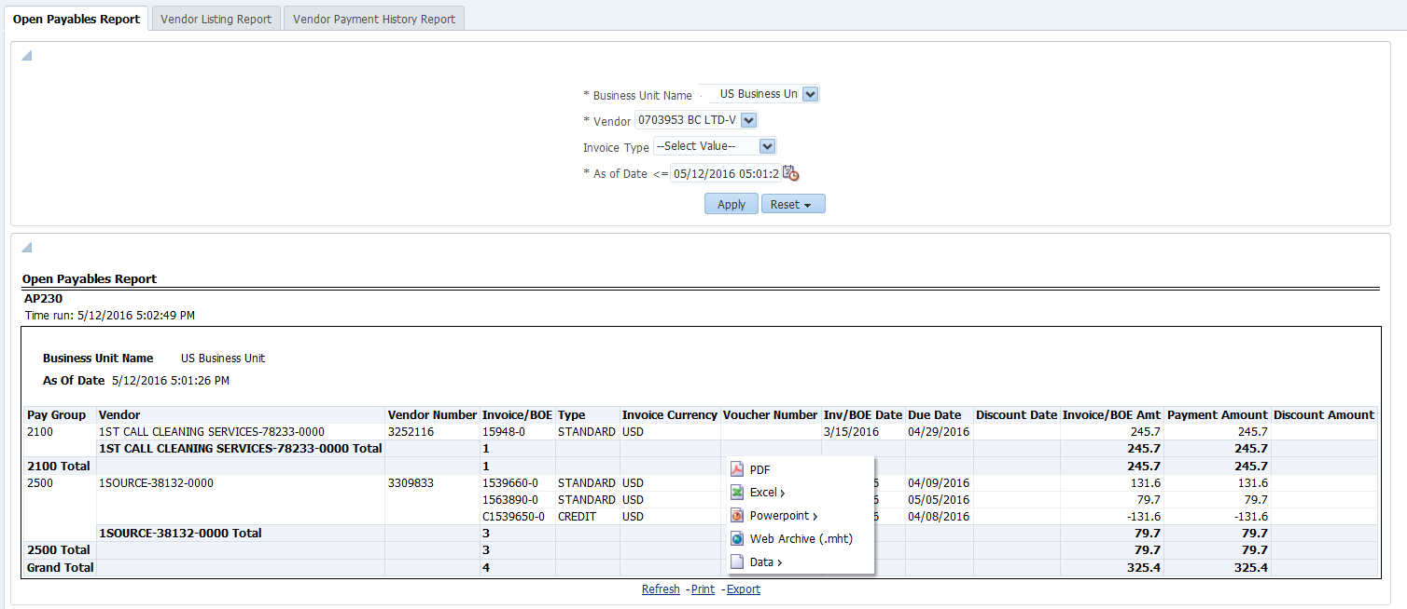
Oracle Transactional Business Intelligence (OTBI)
Why This Tool?
How Does It Work?
Additional Information
Designed for end user and Adhoc reporting - users of this tool do not require knowledge of SQL or the underlying database schemas supporting Oracle Cloud
Pre-packaged content - delivered subject areas provided for drag and drop interface
Data access and security integrated with Oracle Cloud requiring no further setup
Primarily meant for operational users who want to create their own reports and dashboards
OTBI is fully integrated with Oracle Cloud(roles, flex fields, lookups)
There is no need for additional implementation steps to map security or provide configuration inputs
OTBI needs minimum setup and is ready for use once Oracle Cloud is installed and configured
Outputs can be emailed to users / user groups
Scheduling: BI Agents, Ad-hoc (On-Demand)
Customizations of the subject area are not supported; also, limited capabilities to combine subject area
All data attributes are not included in subject areas and dependencies with Oracle if the attribute is not available to select in the output
Performance issues noticed when running complex reports and dependencies with Oracle on performance tuning
Minimal data visualizations, up to 25000 rows
Sample Output

Slide 29
Financial Reporting Studio (FRS)
Why This Tool?
How Does It Work?
Additional Information
Based on near real-time general ledger
account balances
Supports multi-dimensional analysis
Supports multiple output formats, such as HTML, PDF, Excel
Graphical tool makes it easy for users to create reports by dragging and dropping data elements from the accounting hierarchy onto a grid layout
Financial Reporting Center uses an object-oriented graphical report layout
FRS utilizes Oracle Fusion General Ledger balances cube as data source
Installation file is available within the oracle cloud instance – Financial reporting center
Reports can be accessed from Financial Reporting Center
Scheduling: Financial Reporting workspace, Ad-hoc (On-Demand)
Report need to be updated with new member details if there are changes in COA hierarchy levels and their members
Each report has limitation of 1 Million cells and not more than 3 Dimensions can be used in the Report, for better performance
Sample Output
Sample Output

Slide 30
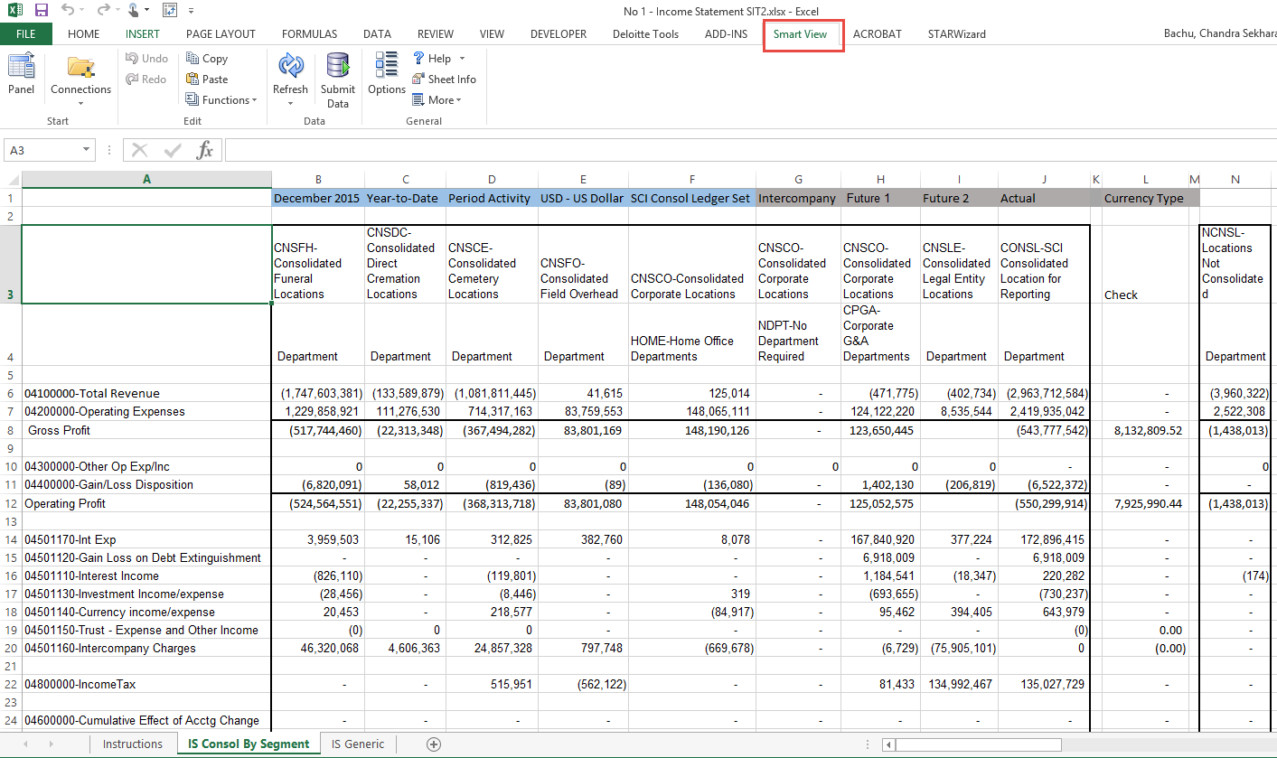
Smart View Reporting
Why This Tool?
How Does It Work?
Additional Information
Excel-based analysis tool that allows quick ad hoc reporting on Oracle tools like Essbase
Allows drag and drop, drill down, and pivoting in MS Excel to manipulate data and perform ad hoc analysis
Smart View reports can be saved off-line and refreshed with latest GL data
Graphs and Charts
Multi Dimensional Analysis
Easy Installation – Excel Add in available under Financial Reports Workspace
Fetches data from Oracle Fusion General Ledger Balances cubes by configuring Essbase connection setup
It’s not a structured reporting tool. User can use free flow mode by pivoting dimensions between rows and columns
Scheduling: Ad-hoc (On-Demand)
Report need to be updated with new member details if there are changes in COA hierarchy levels and their members
On Reopening the spreadsheet user will need to Refresh the spreadsheet to view the latest data
Each report has limitation of 1 Million cells and not more than 3 Dimensions can be used in the Report, for better performance
Sample Output

Slide 31
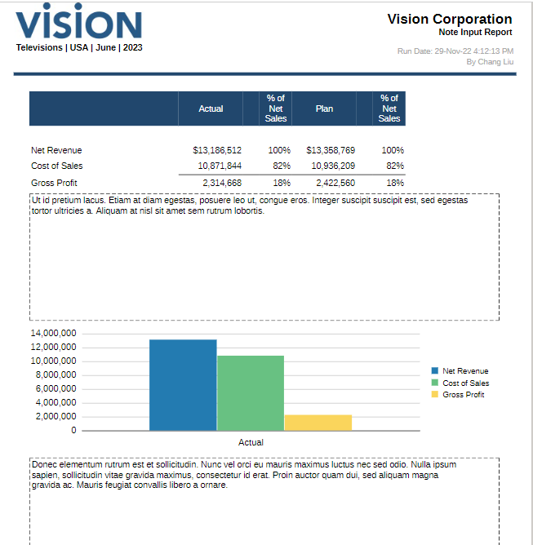
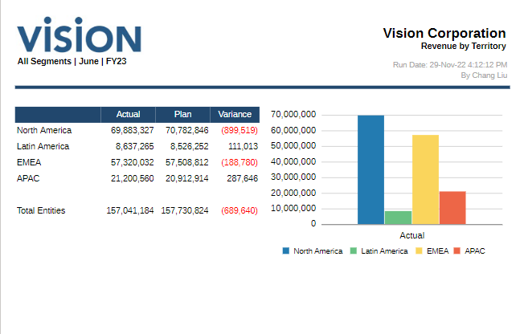
Narrative Reporting
Why This Tool?
How Does It Work?
Additional Information
Deliver faster more accurate insights to all stakeholders by easily combining data and narrative
Excel and Word supported data sources
Supports multiple output formats such as Word, PDF, Excel and HTML
Migrating reports from Financial Reporting to Narrative Reporting is hassle-free
Notifications in the UI and via email
It is a purpose-built business process available in the Oracle EPM Cloud
Narrative Reporting utilizes EPM or ERP cloud as data source
Contains Report Packages, which enable a user to manage the lifecycle of a group of report.
Scheduling: Ad-hoc (On-Demand)
Books cannot be embedded within a report package and report packages cannot be used to group as a book
Sample Output

Slide 32
Artifacts
Oracle Out of Box Reports captured by Process leads based on the discussions from Deep Dive Sessions: OOB Reports
List of Standard Out Of Box Reports provided by Oracle can be found at the below links:
Recording links of the prior reporting strategy and deep dive sessions done on reporting capabilities of Oracle ERP and EPM application suite for reference
Functional Area | Reporting Link
Finance | Financials-Reports
Procurement | Procurement-Reports
SCM | Supply-Chain-Management-Reports
Project | Project-Management
Session | Recording link
Reporting Strategy Session Recording | Technology_Reporting Strategy Session.mp4
EPM Reporting Strategy Recording | OP - EPM Reporting Strategy & Narrative Reporting Session 12.14.2022.mp4
Reporting Tools Demo videos | Reporting Tools Demo Recordings
EPM Narrative reporting - Deep Dive | OP - EPM Narrative Reporting Deep Dive Session - Meeting Recording 01.30.2023.mp4
Oracle Cloud: Subledger Reporting Overview | Subledger Reporting Capabilities Deck and Recording

Slide 33
Reporting Categorization
At a high level, reports can be classified under such categories as operational, management and external reporting to assess the right fit for Cloud reporting tool.
Purpose
Operational Reporting
Management Reporting
External Reporting
A formal document or report which provides the most granular level detail for business transactions and events.
Examples: Item Receipt Detail, Open PO report
Dashboards with multiple visualizations of data with drilldown capabilities to enable management to gain insights from aggregated data.
Examples: Supplier Spend report, Order Book Report
Financial statements including P&L, Balance Sheet and Cash Flow for Multi-GAAP Reporting needs
Examples: 10Q/10K SEC reports, Regulatory report
Usage
Notes:
Drill down feature allows us to visualize granular levels of data in one chart. By “nesting” additional variables of hierarchical data, drill down analysis lets you extract deeper insights without jumping to another chart or report.
Ex: Breaking down sales by continent, country, and city.

Slide 34

Future State Information Delivery Architecture
Seamlessly integrated Financial Enterprise Performance model enables Digital Transformation, Process Improvement, and Workflow Efficiency
EPM & ERP applications will work together to provide operational control, tactical analysis and strategic management outlook needed to drive growth and improvements.
Information model for reporting can be represented by the pyramid below. From transaction/operational detail to summaries, ERP and EPM technology combine to deliver integrated reporting functionality at all levels of operations and financial management.
EPM
Financial Budgeting & Planning
CAPEX Planning
Project Planning
Long Range Planning
Consolidations & Close
Reporting & Analytics
Slice/Dice/Pivot
Strategic
ANALYTICAL
ERP
General Ledger
Accounts Payable
Accounts Receivable
Fixed Assets
Order-to-Cash
Sub-Ledger Accounting
Transactional BI & Reporting
Tactical
Operational
TRANSACTIONAL

Slide 35
Reporting Use Cases Supported By Oracle Cloud
The EPM solution will provide core, supplemental, and analytical external & internal reporting for the finance function.
Primary reporting source
Secondary reporting source
Report Type | ERP | FCC | EPB
External Reporting
Income Statement – Consolidated financial statement of income that forms the basis for external reporting
Balance Sheet – Consolidated financial statement of financial position that forms the basis for external reporting
Cash Flow Statement – Consolidated financial statement of cash flows that forms the basis for external reporting
10K and 10Q – Consolidated financial statements including income statement, balance sheet and statement of cash flows as well as exhibits depicting ratios, detailed views of current asset and liability accounts, pension and benefit obligations, taxes, leases, depreciation, amortization and reconciliations
Variance Package (Actuals) – Financial Summaries of Sales and Profit, detailed income statement, balance sheet and cash flow data, GAAP Adjusted Operating Income and Net Income
Management Reporting
P&L, Balance Sheet, Cash Flow (Actuals) - Revenue, Sales, Gross Profit, EB A, Net Income at an aggregated level, as well, as Balance Sheet and Cash Flow data
Variance Analysis (Actual vs Plan vs Budget/Forecast) – Financials comparison across different scenarios from actuals recorded vs forecasted data
CAPEX – Detailed long-term expenses to be capitalized (e.g. PPE)
OPEX – Detailed Expenses reports for Operating Expenses (Department overheads and Corporate allocations)
Operational Reporting –Logistics, Vendor and Purchasing order reports

Slide 36
Why Narrative Reporting?
Narrative reporting provides a secure, collaborative, and process-driven approach that enables to manage the lifecycle of deliverables from information gathering, review and presenting to stakeholders.
BUSINESS CHALLANGE
PAIN POINTS
NARRATIVE REPORTING SOLUTION
Version Control
Work has been lost or copied over due to mismanagement of shared files
Allows users to store and manage versions of reports in the system
Workflow Management
Authors are not notified when a document is ready for review
Notifies authors and reviewers when a document is ready for input
Document Update Coordination
Multiple authors are making updates to a document at the same time without knowing
Only allows one author to modify a document at a single time
Dynamic Data and Graph Updates
Data tables and graphs are time consuming to update
Data tables and graphs are linked to data sources for real-time updates
Embed Comments & Responses
Comments and responses must be maintained in emails or offline
Comments and review responses are embedded within the document

Slide 37
Narrative Reporting Data Source Diagram
Narrative Reporting enables streamlining internal and external reporting packages with combining data plus textual narrative in a single, secure and collaborative platform.
Data Source(s)
Narrative Reporting
EPB
ERP Cloud GL
REPORT PACKAGE(S)
WORKFLOW
REPORTING
Create report structure
Assign users
TEMPLATE READY
FOR USE
External
Upload narrative sections
Determine due dates
Management
FCC
Flat Files / Other
Embed (link) to data sources

Slide 38


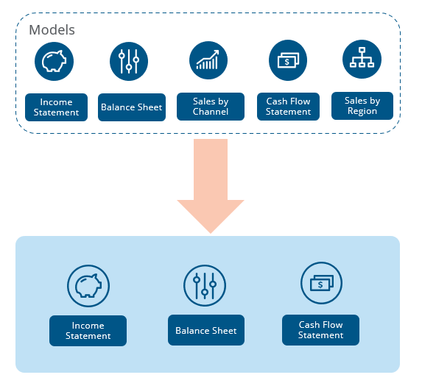

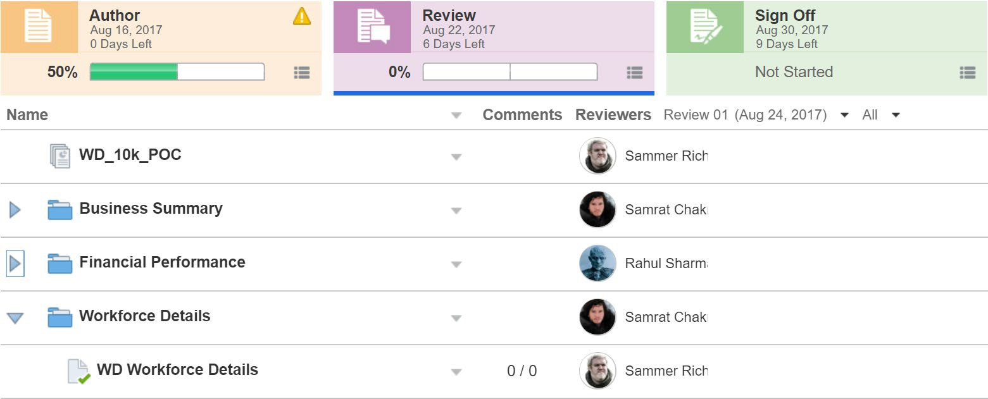




How to Leverage Narrative Reporting?
Report Package
Workflow
Reporting
Package enables ability to structure packages built with a combination of narrative and multiple data sources by using ‘Doclets’, for internal management reporting/external SEC package
Uses variables to drive data refreshes so a singular template can automatically update and be used over multiple periods
Authors open and “check out” doclets (components of an overall reporting package) and update content
Reviewers review content to completion – they can promote to the next phase or reject back to Author
Sign-off is the final phase in the workflow to confirm completion of the reporting package, performed through a digital signature
Reporting packages, once complete, can be distributed to an audience automatically through email
Reports can be internal, for board packages, management updates, or quarterly updates. Or they can be external, such as statutory, regulatory, filing, or annual reports.
WORD
POWE POINT
EXCEL
Narrative Reporting
CUSTOM REPORTS
PDF
WHAT MAKES UP A REPORTING PACKAGE
Report Packages within Narrative Reporting are comprised of multiple “Docklets”. These docklets can consist of:
Microsoft Word
Excel
PowerPoint
PDF
Custom Management Reports

Slide 39
EPM Reporting Overview
Data Grids
Webforms that are utilized to review the data before performing any action
Web Interface allowed for user inputs/adjustments
Dashboards
Visualize the KPIs and other strategic data for your organization
Web Interface
Smart View
Ad hoc reports to answer one-off requests or perform detailed analysis
Pre-configured reports that can be used as a starting point to get to a certain slice of data
Reports
Journals (FCC only)
Management Reporting
Provides details of consolidated journal entries posted as part of the financial consolidation
Standard formats: PDF, HTML and Excel
Upgraded version of FRS with enhanced functionalities
Standard formats: PDF, HTML and Excel
Intercompany(FCC only)
Shows intercompany variance between the trading partners at a balance level
Standard formats: PDF, HTML and Excel

Slide 40
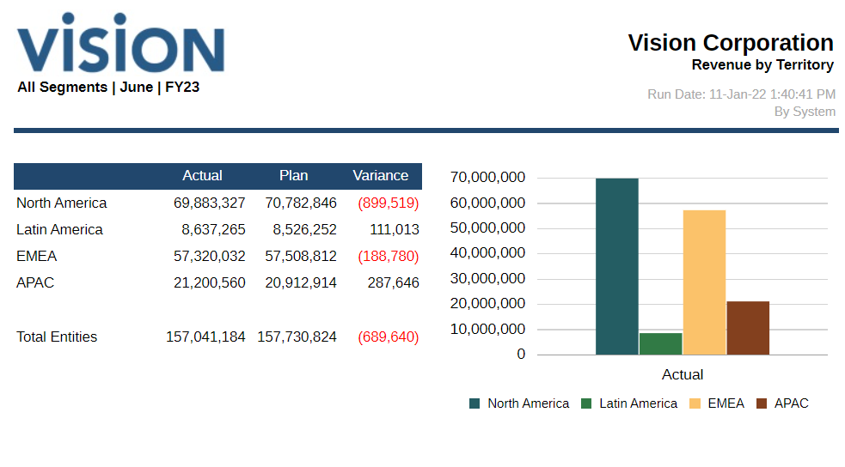
Management Reporting (MR)
Management Reporting provides a user-friendly, robust report development framework along with an enriched report viewer experience.
Key features :
Enhanced charting
Automatic Data Source creation based on EPM cloud application cubes that are on the instance
Create, insert and position report objects
Design and preview individual report objects
Insert formulas and text functions
Conditional formatting, text and Suppression
Enhanced Data Source features
Zoom on parent members
Drill to content, Drill Through & cell file attachments feature
Report Books and Bursting definitions

Slide 41
FCC Management Reporting – Common Use Cases
Consolidated TB | Balance Sheet | P & L | Cash Flow
Trial Balance Detail | Balance Sheet Detail | P&L Detail | Cash Flow Detail
GAAP vs Non-GAAP | Balance Sheet Detail Monthly/Qtrly Trend | P&L Detail Monthly/Qtrly Trend | Comparative Cash Flow
TB Summary by Entity/Regions | Balance Sheet Summary | P&L Summary | Cash vs Non-Cash Summary Movement
IC Elim – Tax view (Alternate Tax Entity structure available) | FX Translation Recon | FX Translation Recon
IC Recon | Equity and Historical Overrides FX Translation
 | Comparative Balance Sheet (Flux Rpt)

Slide 42
EPB Reporting – Common Use Cases
Balance Sheet / Cash Flow Planning | P & L Planning | Projects & Capital Planning | Workforce Planning
Balance Sheet Detail | Revenue Planning Detail | Professional Services – Revenue Summary | Headcount Trends
Balance Sheet Summary | Expense Planning Detail | Professional Services – Expense Summary | New Hires & Departures
Cash Flow Detail | Revenue Variance Actual to Plan / Forecast | Capitalized Assets | Headcount by Area
Cash Flow Summary | Expense Variance Actual to Plan / Forecast |  | Benefits Expense by Area
 | Bookings / ARR Trends |  | Merit Increase Impact
 | P&L Summary |  | Workforce Expense Details

Slide 43
Simplifying the choice: Ad-hoc Vs. Standardized
The final selection of a tool comes down to striking the right balance of information needs for the user.
FRS/Narrative Reporting
Smart View
Dashboards
Ad-hoc
Standardized
Business users to have ability to change reports or create new reports Support ad-hoc analysis and fact finding Easy to use and quick data retrieval for business users Low number of users Require little to no standardization Fairly simple formatting or calculations Comprised of a single data source Have basic performance needs
Specially designed to address a use case Strong formatting capabilities for pixel perfect reports Strong In-Report calculation capabilities Easy for designer to define and control report outline High number of users Require a consistent standard view Contain specific formatting and complex calculations May contain data from multiple sources Require optimal performance during large queries and heavy usage

Slide 44
Decision Data Point Matrix
 | OTBI | BI Publisher | Management Reporting (Previous FRS) | SmartView | Narrative Reporting
Real Time | Yes | Yes | Partial | Partial | Partial
Dashboard Support | Yes | Yes | No | No | No
Ad-hoc Reporting | Yes | Yes | Yes | Yes | Yes
Data Volume | Low | Medium to High | High | High | High
Data Limit | 75K CSV /25K for excel | 300 MB (online) * 500 MB (scheduled) * 15 MB (mail attachment) | 1M Cells | 1M Cells | 30 or less for count 5MB for size
Typical Usage | Ad-Hoc, Dashboards, Headcounts, Drill Downs | Data Listings, Forms, Audits | P&L, Balance Sheet, Account Balance | Drill down of account balance | Cross GL vs EPM, within different EPM modules
Used in both ERP & EPM
Used only in ERP
* Size of XML output data. Configurable.

Slide 45
Reporting Definitions
System of Record – The authoritative source for a particular data element. Data elements should be edited only within their System of Record. Any physical replication of a data element, often necessitated for performance of operational or analytical systems, should be regularly audited against its System of Record to make sure no drift occurs.
System of Reference – The recommended source for decision-making, reporting, and analytics. The System of Reference is synchronized with the Systems of Record. Transcend is the System of Reference for the enterprise.
Operational Systems – The set of applications that power business operations (e.g. Salesforce, Workday, ServiceNow). Operational systems are typically the Systems of Record for operational data elements.
Notes:
Add Data Steward? Master Data Management?

Slide 46
Enterprise Reporting
Transcend is enterprise reporting platform housing Enterprise Data Warehouse that utilizes platform capabilities bringing value to as its first Customer along with integrating data from multiple applications that utilizes for its operations. Reporting utilizing Transcend provides following benefits:
One-stop-shop for integrated enterprise data and reporting
Designed for efficiency and reusability in reporting and analytics
System of Reference for most enterprise data, audited to ensure it reconciles to the Systems of Record
Centralized and standardized role-based security for accessing data
Centralized tools for analysis, visualization, and data science
Data labs for bringing your own data and joining with enterprise data, avoiding costly data replication
Fully documented, layered data architecture, including detailed historical and trending data as well as curated single-source-of-truth metrics and dimensions
Based on products and technology, providing the opportunity for all employees to provide constructive feedback on product quality and enhancements
Notes:
How operationalize?

Slide 47
Application Reporting
Applications may have out of box reporting capabilities. This can offset the need to build the reporting on Transcend, but following points should be investigated before starting to report:
Recommend to use only if
Data requirements are met
The Application has data that is being reported on, requiring no data integration for completeness.
Applications have no mechanisms in place to audit/maintain data for which they are not the System of Record, integrations with other applications are expensive.
Applications are the only source for real-time data.
Reports are available out-of-box
The desired report is available out-of-box within Application.
Applications are not built specifically for reporting and customizations increase the overall cost and complexity of maintaining these systems over time.
Building a custom report/object could lead to increased load on the source application when it uses multiple objects that result in complex joins.
Licensing requirements are met
Ensure that there is enough funding and budget to accommodate the reporting and can be accessed easily by all necessary consumers. Licensing of additional users could be expensive based on application.
Data Security requirements are met
Data security management on Applications can be complex. Some applications may require customization of access policies for reporting which could lead to unnecessary exposure of data.
Notes:
Operational Reporting modifications may be overwritten when operational software is upgraded/updated.

Slide 48
Application Deployment – Reporting Considerations
Catalog data elements for which the application will be the Source of Record
Work with the EAD team to integrate new data elements with the Enterprise LDA
Work with the EAD team to modify LDA processes to replace/supplement current Sources of Record for existing data elements
Work with EAD team to identify/manage new or modified Master Data elements
Identify reporting requirements
Existing Reporting likely needs to be modified if a current Source of Record is being supplemented/replaced
Modifications to the EDS-supported LDA may reduce impact of Source of Record changes
Evaluate if the application supports operational reporting that meet new reporting requirements

Slide 49
Reporting Standards – Self-Service Analytics
Use Power BI with direct query connection to the Semantic Layer in Transcend (preferred)
Power BI dashboards for enterprise-wide reporting and management deep-dive reports
Power BI datasets for self-service business reporting and analytics
Power BI paginated reports for operational reports, which are multi-page data grids and require parametrised experiences, including data-driven, and cascading parameters.
(Exception-based) Business Objects with a Universe that maps directly to the Semantic Layer in Transcend
Vantage Editor – Web-based query tool to access authorized Transcend data
Jupyter (R/Python) - Web-based interactive development environment for advanced analytics
Use Transcend DataLabs for Prototyping or Sharing Analytic efforts
Personal databases – Every employee has their own database under their QuickLook Id on both Production and AWS Platforms. Each of us can logon with our QuickLook Id using our normal network password.

Slide 50
Reporting Glossary
System of Record – The authoritative source for a particular data element. Data elements should be edited only within their System of Record. Any physical replication of a data element, often necessitated for performance of operational or analytical systems, should be regularly audited against its System of Record to make sure no drift occurs.
System of Reference – The recommended source for decision-making, reporting, and analytics. The System of Reference is synchronized with the Systems of Record. Transcend is the System of Reference for the enterprise.
Operational Systems – The set of applications that power business operations (e.g. Salesforce, Workday, ServiceNow). Operational systems are typically the Systems of Record for operational data elements.
Notes:
Add Data Steward? Master Data Management?

Slide 51
Reporting Strategy

Slide 52
Agenda
Reporting Guidelines
Reporting Ecosystem
Methodology
Oracle Reporting Tools
Dispositioning Framework & Rationalization
Reporting Requirement Management
Current State & High-Level Timeline
Known Risks & Mitigation
Appendix

Slide 53





Presenters
Brahmendra Kashyap
Reporting Lead /
Technical Lead
Arthi Rengasamy
Reporting Lead
Sandeep Teja
Reporting Team
Bhupendra Mishra
Solution Architect /
Reporting Lead
Sankar Gopalakrishnan
Reporting Team

Slide 54
Enterprise Architecture Reporting Guidelines
Arthi
Leverage Out-of-box (OOTB) / native application reporting capabilities for business area specific operational reporting and compliance reporting, provided:
Licensing requirements are met for users
Data Security requirements are met for reporting
Data requirements are met – real-time reporting needs, enterprise architecture approved data integration required for completeness, historical data availability
Engage Transcend for development complex management reporting & self-service analytics.
Enterprise-wide management reporting that require data from multiple systems
Management deep-dive reports that require historical trend analysis with complex transformations
Building single source of business representation of data to support with standards for front-end application development
Reporting within a specific business area developed by the business, analytics teams
For prototyping, analytics discovery by combining production data with a new data source to evaluate business value
Note: Data ingestion into Transcend from source applications, including Oracle Cloud, is prioritized based on reporting and analytics needs.

Slide 55
Reporting Ecosystem : Current State
Arthi

Slide 56
Transcend Reporting Patterns: Current State
Arthi
Company Level Reporting
Enterprise Dashboards
Cross-domain Analytics
Self-service Analytics
Adhoc Reporting
Data Reconciliation between systems
Operational: Business Process & Compliance Reporting
Accounting business process
Month-end accounting close process
Operational reports
Prototyping of Analytics
Collaborative Analysis
Operational: Reconciliation Reporting
Audit reports
Data Governance reports
Analytical
Challenge: Limited reporting capabilities on Oracle on-prem ERP solution to support operational and compliance needs
Transactional
Notes:
Operational reports are formal documents or reports which provide the most granular level detail for business transactions and events.

Slide 57
Transcend Reporting Patterns: Future State
Arthi
Analytics / Company Level Reporting
Enterprise Dashboards
Cross-domain analytics
Self-service Analytics
Adhoc Reporting
Data Reconciliation between systems
Operational: Business Process & Compliance Reporting
Accounting business process
Month-end accounting close process
Operational reports
Prototyping of Analytics
Collaborative Analysis
Operational: Reconciliation Reporting
Advanced Analytics
KPI Dashboards
Data Governance reports
Audit reports
Increased focus to derive insights
Analytical
Transactional
Exception Based
Notes:
Operational reports are formal documents or reports which provide the most granular level detail for business transactions and events.

Slide 58
Reporting Ecosystem : Future State (Work-in-progress)
Arthi

Slide 59
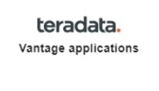
Reporting Ecosystem : Master Data Management (MDM)
Arthi
Federated MDM Architecture
M
MDM Catalog
Analytics Reports
Product
Install Base
Chart of Accounts
Enterprise Data Structure
Tax/Fin Customer Attributes
Location
M
M
Customer Account
Contact
M
M
M
M
Reporting leveraging MDM
M
HR Data
People Data
Component Install Base
Service Attributes - Customer
M
MDM Tables
MDM Dictionary
MDM Glossary
Metrics
M = Master App
Key Takeaways:
Self-service data analytics
1
2
3
Key architectural principle: Master Data, unless by exception, will be integrated to Transcend
Holistic Master Data Management Views will be available for federated data objects in Transcend
Fitting into architectural concept: a Master Data Catalog, Data Dictionaries, Glossaries and Metrics will be available for viewing or reporting master data, regardless of source

Slide 60
Reporting Methodology
Brahmendra
The reporting methodology for Optimus Prime Program is based on the approach outlined below:
We are here
Start
1
2
3
4
5
Rationalization
Define the reporting sources and requirements and identify the tools that will be necessary.
Define the current reporting landscape
Build the reporting needs
Perform Fit-Gap
Review Fit-Gap
Assess requirements to best fit the source system/ reporting tool and prioritize
Template_Link
9
8
7
6
Development
Design, build and test the reports according to the business requirements provided.
Validate the reports based on test cases
Develop the reports based on requirement
Configure role level security to provide read/write access to users
Map business needs to reporting design
10
11
Delivery
Schedule reports when necessary and prepare users for execution and consumption.
Finish
Schedule reports using reporting tools
Train users to enable them to execute and consume reports
and Deloitte Ownership
Dependent on Tool finalized ownership will be decided

Slide 61
Oracle Reporting Tools
Brahmendra
BI Publisher Enables highly formatted operational reports with advanced features such as bursting and scheduling
Financial Reporting Studio/Management Reporting Enables browser-based financials reports for management reporting with real-time drill down capabilities
Smart View Enables excel-based slice-and-dice of data for easy and quick ad-hoc financial reporting
Narrative Reporting (NR)
Enables accessing data from Oracle EPM and Cloud Financials to bring in Charts and Grids with textual narrative in a single report
Oracle Transactional Business Intelligence (OTBI) Enables business users to do self-service reporting on real-time transactional data
** Slide 42 has the links to the demo recordings for these tools

Slide 62
Salesforce Integration Tool and Strategy – Being Evaluated
Brahmendra
Salesforce connect is being evaluated to support the data integration and reporting out of salesforce
Salesforce Connect
Salesforce Report Types:
Transcend GTM Reports – Not in scope for Phase 1B
Ad-hoc Salesforce Reports – In Scope for Phase 1B
Order Header
Order Line
Invoice Header
Invoice Line
Subscription Header
Subscription Line
6 External Objects to be configured in Salesforce
REQ
Ability to configure external object data access in Salesforce to Oracle Cloud ERP via Salesforce Connect (ODATA) integration to Oracle.
APPROACH
Utilize Salesforce connect to integrate with Oracle Cloud | Deloitte
Configure External Objects on the Salesforce platform that will connect to specific Oracle ERP tables | Deloitte
Configure additional Salesforce External Objects to enable data from additional Oracle ERP tables to be displayed within Salesforce
Configure Custom Report Types in Salesforce that join Oracle ERP data to Salesforce data
Build any new Salesforce reports for GTM users that combines and displays transaction-related data from Oracle that is related to Salesforce Accounts, Quotes, and Opportunities

Slide 63
Reporting Tools Rationalization
Brahmendra
The flowchart below illustrates the typical rationalization steps that will be followed to identify the best-fit Reporting Tool for the requirements. Fit-Gap analysis will be performed to leverage standard (Out of the Box) Reports, where available, to meet the requirements.
Notes:
If Oracle Cloud is not target state, Opportunity to leverage source systems and not disposition everything has Transcend

Slide 64
Oracle Decision Data Point Matrix
Brahmendra
 | OTBI | BI Publisher | FRS/Management Reporting | SmartView | Narrative Reporting
Real Time | Yes | Yes | Partial | Partial | Partial
Dashboard Support | Yes | Yes | No | No | No
Ad-hoc Reporting | Yes | Yes | Yes | Yes | Yes
Data Volume | Low | Medium to High | High | High | High
Data Limit | 75K CSV /25K for excel | 300 MB (online) * 500 MB (scheduled) * 15 MB (mail attachment) | 1M Cells | 1M Cells | 30 or less for count 5MB for size
Typical Usage | Ad-Hoc, Dashboards, Headcounts, Drill Downs | Data Listings, Forms, Audits | P&L, Balance Sheet, Account Balance | Drill down of account balance | Cross GL vs EPM, within different EPM modules
* Size of XML output data. Configurable.

Slide 65
Tools Rationalization (Transcend)
Sankar
The flowchart below illustrates the typical rationalization steps that will be followed to identify the best-fit Reporting Tool for the requirements. Fit-Gap analysis will be performed to leverage standard (Out of the Box) Reports, where available, to meet the requirements.
Is this report for enterprise- wide use?
No
No
No
Is this an Operational Report?
No
Is this an audit
or compliance Report?
Start
Is Self-Service reporting possible?
Is this a Management
report?
No
Yes
Yes
Yes
Yes
Power BI Dashboard
Review the business case
and why can’t
application OOTB report?
Review the reporting pattern and recommend any other tool in the current ecosystem if PBI/BO cannot be used
Can Power BI handle?
Can Power BI handle?
Yes
No
Yes
Approved
Rejected
Power BI Datasets
Business Objects Universe
Power BI Dashboard
Power BI Paginated Reports
Send to application reporting review and work with business team
Notes:
Self-service
PowerBI and Business Objects – Pre-canned
Change Management – Assess/evaluate needs for PowerBI usage training and enablement

Slide 66
Report Dispositioning – Next Steps
Sandeep / Arthi
1.2: Reporting user stories from workshops
Add User stories to Reporting list
Phase prioritization
Initial FIT/GAP
Clarification question for SMES
Update priority, and other reporting template columns
High level reporting requirement
Mapping to target reporting tool/systems
1.1: Reporting Requirement from Template
2.1: Initial analysis by Deloitte Leads
3: Review with Reporting SMEs
4: Reporting Tool rationalization for requirements
2.2: Initial analysis by Reporting Leads for Transcend Reports
5: Report prioritization
6: Reporting Deep Dives
(Sprint Cycle)
7: Lean Spec generation for custom Report
8.1: Reporting Development
Sprint assignment
Roles
8.2: Report Configuration for OOB Reports
Deloitte Workstream
Lead
Functional Leads
SMEs
Reporting Leads
ITLeads
Checkpoints
PMO, GBPO

Slide 67
Reporting Activities – Prioritization, Dependencies etc.,
Sandeep
Phase Assignment – As part of the report dispositioning, reports will be mapped to OP phases(1A/1B/2) in alignment with the overall program implementation plan
Prioritization – After the report disposition steps are completed, with consensus with the workstream/ Reporting team, a list of custom reports that are needed to be in the Future State will be finalized. team is expected to share the priority of the reports for development based on Business criticality and other factors
Dependencies – During the disposition phase and the deep dive discussions with workstreams regarding reporting requirements, reporting dependencies (example: if a report cuts across more than 1 workstream or more than 1 application) will be identified and the corresponding workstreams/applications will be assigned ownership
Build the Backlog – Reporting backlog for development will be built based on the phase-wise assignment of the report and criticality defined by team. These will be later mapped to development sprints of the phase for report development
Sprint Assignment – Backlog reports will be assigned to sprints and all the report level activities like development, Technical Unit Testing, Functional Unit Testing etc., and report delivery will be tracked accordingly
Notes:
Add Data Steward? Master Data Management?

Slide 68
Workstream Reporting SMEs
Sandeep / Sankar
List of Reporting SMEs identified from each vertical workstreams.
Contacts
Workstream | Sponsor | GBPO | Functional Lead | IT Lead | Reporting SME
Lead to Quote | Evan Randall | Will Wu | Jim Maher, Szymon Dziocha | Danny Pulache | Steven Gifford, Justin Evans
Order to Fulfill | Charles Smotherman | Steven Deluca | Susan Stalcup, Derrell White | Chris Marsh, Naveen Jain | Susan Stalcup
Issue to Resolution | Alex Console | Ann Grimes | Kirk Balingit | Senthil Kesavan | Aznan Hasan Khan, Kevin M Philips
Invoice to Cash | Charles Smotherman | Steven Deluca | Susan Stalcup, Helen Freeman | Dermot Doyle | Susan Stalcup
Record to Report | Charles Smotherman | Eric Leis | Kelly Burns | Anthony Coleman | Kelly Burns
Plan to Perform | Rich Shane | Allison Ross | Patrick Nigro | Anthony Coleman | Patrick Nigro
Source to Pay | Charles Smotherman, Erica Hausheer | Amanda Patterson | Elliott Ulmer, Linda Persina | Naveen Jain | Vinith Kumar (Procurement), Nancy Ma (Payables)
Tax & Treasury | Charles Smotherman | Laura Jividen | Doug Bryan, Celeste Tam, Brian Pierson | Anthony Coleman | Doug Bryan, Celeste Tam, David Chrisman (Treasury)
Prof. Services Projects | Rich Shane | Jim Lewis | Patrick Berger | Atieh Akbar, Ellie Bluestein | Patrick Berger

Slide 69
Responsibility Matrix (Oracle Cloud Reporting Ownership)
Sandeep
This Responsible, Approver, Consulted, and Informed (RACI) matrix is built specific to the steps involved in building the reports identified as part of implementation project.
RACI Matrix
Tasks | Functional Leads | GBPO | Reporting Team | Tech Team | Deloitte Functional Team | Deloitte Tech Team
Reports Business Requirements | R/A | R/A | C | I | C | I
Functional Design & Configuration | C/A | C/A | I | C | R | C
Technical Design & Build | C | C | C | C/A | C | R
Code Migration | I | I | I | C/A | I | R
Unit Testing—Technical | I | I | I | C/A | C | R
Unit Testing—Functional | I | I | I | C | R/A | C
Integration Testing | I | I | I | C | R/A | C
User Acceptance Testing | R/A | R/A | C | C | C | C
Cutover Tasks | C | C | R | R | C | R

Slide 70
Responsibility Matrix (Salesforce & Oracle Cloud ERP Integration Ownership)
Sandeep
This Responsible, Approver, Consulted, and Informed (RACI) matrix is built specific to the steps involved in building the reports identified as part of implementation project.
RACI Matrix
Tasks | Functional Leads | GBPO | Reporting Team | Tech Team | Deloitte Functional Team | Deloitte Tech Team
Reports Business Requirements | R/A | R/A | C | I | C | I
Functional Design & Configuration | C/A | C/A | I | C | R | C
Technical Design & Build | C | C | C | C/A | C | R
Code Migration | I | I | I | C/A | I | R
Unit Testing—Technical | I | I | I | C/A | C | R
Unit Testing—Functional | I | I | I | C | R/A | C
Integration Testing | I | I | I | C | R/A | C
User Acceptance Testing | R/A | R/A | C | C | C | C
Cutover Tasks | C | C | R | R | C | R

Slide 71
Responsibility Matrix (Custom Transcend Reporting Ownership)
Sandeep
This Responsible, Approver, Consulted, and Informed (RACI) matrix is built specific to the steps involved in building the reports identified as part of implementation project.
RACI Matrix
Tasks | Functional Leads | GBPO | Reporting Team | Transcend Functional Team | Transcend Tech Team | Deloitte Functional Team | Deloitte Tech Team
Reports Business Requirements | R/A | R/A | C | C | I | I | I
Functional Design & Wireframe | C/A | C/A | I | R | C | I | I
Prototyping | C/A | C/A | I | R | R | I | I
Technical Design | C | C | C | C | R | R* | C
Data Ingestion | I | I | I | R/C | R | C | R#
Coding and Unit Testing | I | I | I | C | R | C | C
Functional Testing | I | I | I | R/A | C | C | C
Integration Testing | I | I | I | R/A | C | C | C
User Acceptance Testing | R/A | R/A | C | C | C | C | C
Data Security | A | A | C | R | R | C | C
Go Live | C | C | R | R | R | C | C
R* - Deloitte Functional team will work with for mapping details from Oracle cloud
R# - Deloitte Technical team will share the data extract as requested by Transcend for reporting

Slide 72
Responsibility Matrix (Other Boundary System Reporting Ownership) – IT or BI teams from business
Sandeep
This Responsible, Approver, Consulted, and Informed (RACI) matrix is built specific to the steps involved in building the reports identified as part of implementation project.
RACI Matrix
Tasks | Functional Leads | GBPO | Boundary System Application development Team | Deloitte Functional Team | Deloitte Tech Team
Reports Business Requirements | R/A | R/A | C | I | I
Functional Design & Configuration | C/A | C/A | R | I | I
Technical Design & Build | C | C | R | I | I
Code Migration | I | I | R | I | I
Unit Testing—Technical | I | I | R | I | I
Unit Testing—Functional | I | I | R | I | I
Integration Testing | I | I | R | I | I
User Acceptance Testing | R/A | R/A | R | I | I
Cutover Tasks | C | C | R | I | I

Slide 73
Oracle Reporting Security – BIP, OTBI and FRS
Sandeep
Reporting security roles provide the end-user functional privileges for reporting. Users will be assigned roles based on their job duties.
Report Descriptions
How is access controlled? *
Business
Intelligence
Publisher
Used to create highly formatted transactional reports (i.e., check print reports)
SaaS
Transactional Data
Data Security
Reporting Roles
Oracle
Transactional
Business
Intelligence (OTBI)
OTBI is used for ad hoc reporting on real time transactional data
Available only through cloud financials.
Folder Security
Transactional Duties
Financial
Reporting
Studio (FRS)
FRS reports are primarily for management reporting
Available only through cloud financials.
Balances
Subject Areas
The information displayed in an OTBI report is based on the end-user’s data security access. “What you see in the application screen is what you will see in the report”
73

Slide 74
Transcend Report Data Security
Sankar
Application level: Access to a cross-domain dashboard or analytics application (PBI, Business Objects)
Module level: Access to a specific data subject area and/or application module (ARR or Revenue or Expense data in a dashboard)
Row level: Limit data available to view for that user (Row level security for regional hierarchy, planning organization and others)
Notes:
Opportunity to simplify, standardize & streamline implementation of security in Transcend
Leverage Deloitte's experience in ERP data security for analytics

Slide 75
Reporting Requirement - Current State
Sandeep
Workstream | No. of Reports
Record to Report | 166
Lead to Quote | 49
Invoice to Cash | 55
Order to Fulfill | 137
Procure to Pay | 9
Plan to Perform | 65
Source to Pay | 120
Issue to Resolution | 71
Tax & Treasury | 9
Prof. Services Projects | 17
TBD | 48

Slide 76
Reporting Workstream: Key Risk Mitigation
Arthi
AREA | RISK | Mitigation Plan | NOTES
Reporting scope of work not defined by phase, team | Global design exit for reporting workstream without completion of the initial dispositioning of requirements and building the user story backlog for reporting by phase, team. The number requests for reporting per workstream is high and the level of detail captured is insufficient to assess level of effort by phase | Initial prioritization and high level disposition of the requirements to be completed within 2 weeks of global design exit. Enlist GBPO and functional lead support to rationalize, consolidate and prioritize reporting requirements by phase. Please click here for process | Reporting work was deprioritized over the business process discussions and WTW preparation. Deloitte has a limited capacity reserved for custom reporting implementation for the entire OP program. Change Management to be exercised, based on PMO guidance.
Requirements management | The user stories for the functional workstreams are not complete and there may be reporting user stories captured after the initial dispositioning | Enlist GBPO and functional leads' support to review output of the dispositioning process to identify any key gaps in reporting requirements by phase. Dependencies across functional and other horizontal workstreams will be captured in detailed design. Finalize the data integration approach to ingest module level data into Transcend. Note: Data to be ingested into Transcend will be prioritized based on reporting and analytic needs | GBPO and functional leads have provided the initial list of reporting requirements. Exception based reporting user stories expected to be captured by functional leads during detailed design.
Oracle OOTB capability evaluation | Oracle OOTB reporting capabilities assessment not completed to confirm that NO GAPS exist to support the critical to finance business close processes. Any custom development by reporting teams will take time and may affect the overall timeline of the subsequent phases of the program | User stories for critical to finance business close processes are captured and will be prioritized during the dispositioning process. Oracle custom reports to be evaluated to fit any gaps identified. Discussions to be planned with GBPOs/functional leads to evaluate process changes before investing in custom reports Only exception based complex operational reporting (Ex: data from multiple systems) to be prioritized for Transcend

Slide 77
Report Dispositioning – Steps and subsequent activities
DRAFT
Sandeep
M3 | M4 | M5 | M6 | M7 | M8 | M9 | M10 | M11 | M12 | M13 | M14 | M15
Dec | Jan | Feb | Mar | Apr | May | Jun | Jul | Aug | Sep | Oct | Nov | Dec
Gather the reporting requirement list from
Initial dispositioning/analysis
Deep dive sessions for 1 Reports
Prioritization into phases 1A,1B and 2
Prioritization within sprint for 1A
Lean Spec generation
Reporting Timeline
Development Sprint – 1A
INT1 – 1A
UAT – 1A
Phase 1a
ERP Go Live
Phase 1a
EPM Go Live
Report Build
TUT and FUT
Development Sprint – 1B
UAT – 1B
Solution Lifecycle Stages
Imagine
Deliver
Run

Slide 78
Reporting Guiding principles
Brahmendra
Data Privacy
Report Category
Report Access
Data Volume
Report Format
Level of Reporting
The reporting solution is driven by a set of guiding principles that help align the factors involved in the reporting implementation methodology
Customer data
Internal data
Public data
High Volume
Low Volume
Batch extracts
HTML
Excel
PDF
Dashboard
Management
Transactional
Period Close
Analytical
Business Group
Legal Entity
Business Unit
Business Functions
Power Users Business Users
Principle | Benefits
Single source of truth | Enables true performance measurement and metrics usage across the organization Provides factual understanding and confidence in reporting
Information consistency | Drives commonality and consistency in decision-making across disparate functions and levels of the organization
Rationalized toolsets | Enforces standards to enable reliability and rapid development Limited toolsets reduce training effort and promotes transferability
Clearly defined access | Provides users with appropriate view of enterprise information
Minimal custom reports | Reduces maintenance efforts and eases impact on upgrade initiatives Leverage application provided Out-of-box reports, custom reports are a cost to the company

Slide 79
BI Publisher Reports
Why This Tool?
How Does It Work?
Additional Information
Flexibility to write SQL queries or tune performance; remove dependencies with Oracle for delivering OTBI attributes
Picture Perfect Reporting
Allow multiple output formats like pdf, html, rtf, excel
Support for Bursting options to multiple destinations
High volume data reports can be developed
Supports calculations though SQL queries
Dataset(s) generate runtime XML from a single or multiple data sources
Generated XML is parsed though a static template for a single or multiple output(s) in different formats
Report output can be delivered using delivery options (ex – Email, SFTP)
Scheduling: BI report job, ESS jobs, Ad-hoc (On-Demand)
Developer Centric Tool and Users should have some basic to advanced knowledge of SQL
Complex BI reports can take significant development time
No drill-down and drill-through capabilities
Users cannot make changes to report based on their needs
Sample Output

Slide 80
Oracle Transactional Business Intelligence (OTBI)
Why This Tool?
How Does It Work?
Additional Information
Designed for end user and Adhoc reporting - users of this tool do not require knowledge of SQL or the underlying database schemas supporting Oracle Cloud
Pre-packaged content - delivered subject areas provided for drag and drop interface
Data access and security integrated with Oracle Cloud requiring no further setup
Primarily meant for operational users who want to create their own reports and dashboards
OTBI is fully integrated with Oracle Cloud(roles, flex fields, lookups)
There is no need for additional implementation steps to map security or provide configuration inputs
OTBI needs minimum setup and is ready for use once Oracle Cloud is installed and configured
Outputs can be emailed to users / user groups
Scheduling: BI Agents, Ad-hoc (On-Demand)
Customizations of the subject area are not supported; also, limited capabilities to combine subject area
All data attributes are not included in subject areas and dependencies with Oracle if the attribute is not available to select in the output
Performance issues noticed when running complex reports and dependencies with Oracle on performance tuning
Minimal data visualizations, up to 25000 rows
Sample Output

Slide 81
Financial Reporting Studio (FRS)
Why This Tool?
How Does It Work?
Additional Information
Based on near real-time general ledger
account balances
Supports multi-dimensional analysis
Supports multiple output formats, such as HTML, PDF, Excel
Graphical tool makes it easy for users to create reports by dragging and dropping data elements from the accounting hierarchy onto a grid layout
Financial Reporting Center uses an object-oriented graphical report layout
FRS utilizes Oracle Fusion General Ledger balances cube as data source
Installation file is available within the oracle cloud instance – Financial reporting center
Reports can be accessed from Financial Reporting Center
Scheduling: Financial Reporting workspace, Ad-hoc (On-Demand)
Report need to be updated with new member details if there are changes in COA hierarchy levels and their members
Each report has limitation of 1 Million cells and not more than 3 Dimensions can be used in the Report, for better performance
Sample Output
Sample Output

Slide 82
Smart View Reporting
Why This Tool?
How Does It Work?
Additional Information
Excel-based analysis tool that allows quick ad hoc reporting on Oracle tools like Essbase
Allows drag and drop, drill down, and pivoting in MS Excel to manipulate data and perform ad hoc analysis
Smart View reports can be saved off-line and refreshed with latest GL data
Graphs and Charts
Multi Dimensional Analysis
Easy Installation – Excel Add in available under Financial Reports Workspace
Fetches data from Oracle Fusion General Ledger Balances cubes by configuring Essbase connection setup
It’s not a structured reporting tool. User can use free flow mode by pivoting dimensions between rows and columns
Scheduling: Ad-hoc (On-Demand)
Report need to be updated with new member details if there are changes in COA hierarchy levels and their members
On Reopening the spreadsheet user will need to Refresh the spreadsheet to view the latest data
Each report has limitation of 1 Million cells and not more than 3 Dimensions can be used in the Report, for better performance
Sample Output

Slide 83
Narrative Reporting
Why This Tool?
How Does It Work?
Additional Information
Deliver faster more accurate insights to all stakeholders by easily combining data and narrative
Excel and Word supported data sources
Supports multiple output formats such as Word, PDF, Excel and HTML
Migrating reports from Financial Reporting to Narrative Reporting is hassle-free
Notifications in the UI and via email
It is a purpose-built business process available in the Oracle EPM Cloud
Narrative Reporting utilizes EPM or ERP cloud as data source
Contains Report Packages, which enable a user to manage the lifecycle of a group of report.
Scheduling: Ad-hoc (On-Demand)
Books cannot be embedded within a report package and report packages cannot be used to group as a book
Sample Output

Slide 84
Artifacts
Oracle Out of Box Reports captured by Process leads based on the discussions from Deep Dive Sessions: OOB Reports
List of Standard Out Of Box Reports provided by Oracle can be found at the below links:
Recording links of the prior reporting strategy and deep dive sessions done on reporting capabilities of Oracle ERP and EPM application suite for reference
Functional Area | Reporting Link
Finance | Financials-Reports
Procurement | Procurement-Reports
SCM | Supply-Chain-Management-Reports
Project | Project-Management
Session | Recording link
Reporting Strategy Session Recording | Technology_Reporting Strategy Session.mp4
EPM Reporting Strategy Recording | OP - EPM Reporting Strategy & Narrative Reporting Session 12.14.2022.mp4
Reporting Tools Demo videos | Reporting Tools Demo Recordings
EPM Narrative reporting - Deep Dive | OP - EPM Narrative Reporting Deep Dive Session - Meeting Recording 01.30.2023.mp4
Oracle Cloud: Subledger Reporting Overview | Subledger Reporting Capabilities Deck and Recording

Slide 85
Reporting Categorization
At a high level, reports can be classified under such categories as operational, management and external reporting to assess the right fit for Cloud reporting tool.
Purpose
Operational Reporting
Management Reporting
External Reporting
A formal document or report which provides the most granular level detail for business transactions and events.
Examples: Item Receipt Detail, Open PO report
Dashboards with multiple visualizations of data with drilldown capabilities to enable management to gain insights from aggregated data.
Examples: Supplier Spend report, Order Book Report
Financial statements including P&L, Balance Sheet and Cash Flow for Multi-GAAP Reporting needs
Examples: 10Q/10K SEC reports, Regulatory report
Usage
Notes:
Drill down feature allows us to visualize granular levels of data in one chart. By “nesting” additional variables of hierarchical data, drill down analysis lets you extract deeper insights without jumping to another chart or report.
Ex: Breaking down sales by continent, country, and city.

Slide 86
Future State Information Delivery Architecture
Seamlessly integrated Financial Enterprise Performance model enables Digital Transformation, Process Improvement, and Workflow Efficiency
EPM & ERP applications will work together to provide operational control, tactical analysis and strategic management outlook needed to drive growth and improvements.
Information model for reporting can be represented by the pyramid below. From transaction/operational detail to summaries, ERP and EPM technology combine to deliver integrated reporting functionality at all levels of operations and financial management.
EPM
Financial Budgeting & Planning
CAPEX Planning
Project Planning
Long Range Planning
Consolidations & Close
Reporting & Analytics
Slice/Dice/Pivot
Strategic
ANALYTICAL
ERP
General Ledger
Accounts Payable
Accounts Receivable
Fixed Assets
Order-to-Cash
Sub-Ledger Accounting
Transactional BI & Reporting
Tactical
Operational
TRANSACTIONAL

Slide 87
Reporting Use Cases Supported By Oracle Cloud
The EPM solution will provide core, supplemental, and analytical external & internal reporting for the finance function.
Primary reporting source
Secondary reporting source
Report Type | ERP | FCC | EPB
External Reporting
Income Statement – Consolidated financial statement of income that forms the basis for external reporting
Balance Sheet – Consolidated financial statement of financial position that forms the basis for external reporting
Cash Flow Statement – Consolidated financial statement of cash flows that forms the basis for external reporting
10K and 10Q – Consolidated financial statements including income statement, balance sheet and statement of cash flows as well as exhibits depicting ratios, detailed views of current asset and liability accounts, pension and benefit obligations, taxes, leases, depreciation, amortization and reconciliations
Variance Package (Actuals) – Financial Summaries of Sales and Profit, detailed income statement, balance sheet and cash flow data, GAAP Adjusted Operating Income and Net Income
Management Reporting
P&L, Balance Sheet, Cash Flow (Actuals) - Revenue, Sales, Gross Profit, EBIA, Net Income at an aggregated level, as well, as Balance Sheet and Cash Flow data
Variance Analysis (Actual vs Plan vs Budget/Forecast) – Financials comparison across different scenarios from actuals recorded vs forecasted data
CAPEX – Detailed long-term expenses to be capitalized (e.g. PPE)
OPEX – Detailed Expenses reports for Operating Expenses (Department overheads and Corporate allocations)
Operational Reporting –Logistics, Vendor and Purchasing order reports

Slide 88
Why Narrative Reporting?
Narrative reporting provides a secure, collaborative, and process-driven approach that enables to manage the lifecycle of deliverables from information gathering, review and presenting to stakeholders.
BUSINESS CHALLANGE
PAIN POINTS
NARRATIVE REPORTING SOLUTION
Version Control
Work has been lost or copied over due to mismanagement of shared files
Allows users to store and manage versions of reports in the system
Workflow Management
Authors are not notified when a document is ready for review
Notifies authors and reviewers when a document is ready for input
Document Update Coordination
Multiple authors are making updates to a document at the same time without knowing
Only allows one author to modify a document at a single time
Dynamic Data and Graph Updates
Data tables and graphs are time consuming to update
Data tables and graphs are linked to data sources for real-time updates
Embed Comments & Responses
Comments and responses must be maintained in emails or offline
Comments and review responses are embedded within the document

Slide 89
Narrative Reporting Data Source Diagram
Narrative Reporting enables streamlining internal and external reporting packages with combining data plus textual narrative in a single, secure and collaborative platform.
Data Source(s)
Narrative Reporting
EPB
ERP Cloud GL
REPORT PACKAGE(S)
WORKFLOW
REPORTING
Create report structure
Assign users
TEMPLATE READY
FOR USE
External
Upload narrative sections
Determine due dates
Management
FCC
Flat Files / Other
Embed (link) to data sources

Slide 90
How to Leverage Narrative Reporting?
Report Package
Workflow
Reporting
Package enables ability to structure packages built with a combination of narrative and multiple data sources by using ‘Doclets’, for internal management reporting/external SEC package
Uses variables to drive data refreshes so a singular template can automatically update and be used over multiple periods
Authors open and “check out” doclets (components of an overall reporting package) and update content
Reviewers review content to completion – they can promote to the next phase or reject back to Author
Sign-off is the final phase in the workflow to confirm completion of the reporting package, performed through a digital signature
Reporting packages, once complete, can be distributed to an audience automatically through email
Reports can be internal, for board packages, management updates, or quarterly updates. Or they can be external, such as statutory, regulatory, filing, or annual reports.
WORD
POWE POINT
EXCEL
Narrative Reporting
CUSTOM REPORTS
PDF
WHAT MAKES UP A REPORTING PACKAGE
Report Packages within Narrative Reporting are comprised of multiple “Docklets”. These docklets can consist of:
Microsoft Word
Excel
PowerPoint
PDF
Custom Management Reports

Slide 91
EPM Reporting Overview
Data Grids
Webforms that are utilized to review the data before performing any action
Web Interface allowed for user inputs/adjustments
Dashboards
Visualize the KPIs and other strategic data for your organization
Web Interface
Smart View
Ad hoc reports to answer one-off requests or perform detailed analysis
Pre-configured reports that can be used as a starting point to get to a certain slice of data
Reports
Journals (FCC only)
Management Reporting
Provides details of consolidated journal entries posted as part of the financial consolidation
Standard formats: PDF, HTML and Excel
Upgraded version of FRS with enhanced functionalities
Standard formats: PDF, HTML and Excel
Intercompany(FCC only)
Shows intercompany variance between the trading partners at a balance level
Standard formats: PDF, HTML and Excel

Slide 92
Management Reporting (MR)
Management Reporting provides a user-friendly, robust report development framework along with an enriched report viewer experience.
Key features :
Enhanced charting
Automatic Data Source creation based on EPM cloud application cubes that are on the instance
Create, insert and position report objects
Design and preview individual report objects
Insert formulas and text functions
Conditional formatting, text and Suppression
Enhanced Data Source features
Zoom on parent members
Drill to content, Drill Through & cell file attachments feature
Report Books and Bursting definitions

Slide 93
FCC Management Reporting – Common Use Cases
Consolidated TB | Balance Sheet | P & L | Cash Flow
Trial Balance Detail | Balance Sheet Detail | P&L Detail | Cash Flow Detail
GAAP vs Non-GAAP | Balance Sheet Detail Monthly/Qtrly Trend | P&L Detail Monthly/Qtrly Trend | Comparative Cash Flow
TB Summary by Entity/Regions | Balance Sheet Summary | P&L Summary | Cash vs Non-Cash Summary Movement
IC Elim – Tax view (Alternate Tax Entity structure available) | FX Translation Recon | FX Translation Recon
IC Recon | Equity and Historical Overrides FX Translation
 | Comparative Balance Sheet (Flux Rpt)

Slide 94
EPB Reporting – Common Use Cases
Balance Sheet / Cash Flow Planning | P & L Planning | Projects & Capital Planning | Workforce Planning
Balance Sheet Detail | Revenue Planning Detail | Professional Services – Revenue Summary | Headcount Trends
Balance Sheet Summary | Expense Planning Detail | Professional Services – Expense Summary | New Hires & Departures
Cash Flow Detail | Revenue Variance Actual to Plan / Forecast | Capitalized Assets | Headcount by Area
Cash Flow Summary | Expense Variance Actual to Plan / Forecast |  | Benefits Expense by Area
 | Bookings / ARR Trends |  | Merit Increase Impact
 | P&L Summary |  | Workforce Expense Details

Slide 95
Simplifying the choice: Ad-hoc Vs. Standardized
The final selection of a tool comes down to striking the right balance of information needs for the user.
FRS/Narrative Reporting
Smart View
Dashboards
Ad-hoc
Standardized
Business users to have ability to change reports or create new reports Support ad-hoc analysis and fact finding Easy to use and quick data retrieval for business users Low number of users Require little to no standardization Fairly simple formatting or calculations Comprised of a single data source Have basic performance needs
Specially designed to address a use case Strong formatting capabilities for pixel perfect reports Strong In-Report calculation capabilities Easy for designer to define and control report outline High number of users Require a consistent standard view Contain specific formatting and complex calculations May contain data from multiple sources Require optimal performance during large queries and heavy usage

Slide 96
Decision Data Point Matrix
 | OTBI | BI Publisher | Management Reporting (Previous FRS) | SmartView | Narrative Reporting
Real Time | Yes | Yes | Partial | Partial | Partial
Dashboard Support | Yes | Yes | No | No | No
Ad-hoc Reporting | Yes | Yes | Yes | Yes | Yes
Data Volume | Low | Medium to High | High | High | High
Data Limit | 75K CSV /25K for excel | 300 MB (online) * 500 MB (scheduled) * 15 MB (mail attachment) | 1M Cells | 1M Cells | 30 or less for count 5MB for size
Typical Usage | Ad-Hoc, Dashboards, Headcounts, Drill Downs | Data Listings, Forms, Audits | P&L, Balance Sheet, Account Balance | Drill down of account balance | Cross GL vs EPM, within different EPM modules
Used in both ERP & EPM
Used only in ERP
* Size of XML output data. Configurable.

Slide 97
Reporting Definitions
System of Record – The authoritative source for a particular data element. Data elements should be edited only within their System of Record. Any physical replication of a data element, often necessitated for performance of operational or analytical systems, should be regularly audited against its System of Record to make sure no drift occurs.
System of Reference – The recommended source for decision-making, reporting, and analytics. The System of Reference is synchronized with the Systems of Record. Transcend is the System of Reference for the enterprise.
Operational Systems – The set of applications that power business operations (e.g. Salesforce, Workday, ServiceNow). Operational systems are typically the Systems of Record for operational data elements.
Notes:
Add Data Steward? Master Data Management?

Slide 98
Enterprise Reporting
Transcend is enterprise reporting platform housing Enterprise Data Warehouse that utilizes platform capabilities bringing value to as its first Customer along with integrating data from multiple applications that utilizes for its operations. Reporting utilizing Transcend provides following benefits:
One-stop-shop for integrated enterprise data and reporting
Designed for efficiency and reusability in reporting and analytics
System of Reference for most enterprise data, audited to ensure it reconciles to the Systems of Record
Centralized and standardized role-based security for accessing data
Centralized tools for analysis, visualization, and data science
Data labs for bringing your own data and joining with enterprise data, avoiding costly data replication
Fully documented, layered data architecture, including detailed historical and trending data as well as curated single-source-of-truth metrics and dimensions
Based on products and technology, providing the opportunity for all employees to provide constructive feedback on product quality and enhancements
Notes:
How operationalize?

Slide 99
Application Reporting
Applications may have out of box reporting capabilities. This can offset the need to build the reporting on Transcend, but following points should be investigated before starting to report:
Recommend to use only if
Data requirements are met
The Application has data that is being reported on, requiring no data integration for completeness.
Applications have no mechanisms in place to audit/maintain data for which they are not the System of Record, integrations with other applications are expensive.
Applications are the only source for real-time data.
Reports are available out-of-box
The desired report is available out-of-box within Application.
Applications are not built specifically for reporting and customizations increase the overall cost and complexity of maintaining these systems over time.
Building a custom report/object could lead to increased load on the source application when it uses multiple objects that result in complex joins.
Licensing requirements are met
Ensure that there is enough funding and budget to accommodate the reporting and can be accessed easily by all necessary consumers. Licensing of additional users could be expensive based on application.
Data Security requirements are met
Data security management on Applications can be complex. Some applications may require customization of access policies for reporting which could lead to unnecessary exposure of data.
Notes:
Operational Reporting modifications may be overwritten when operational software is upgraded/updated.

Slide 100
Application Deployment – Reporting Considerations
Catalog data elements for which the application will be the Source of Record
Work with the EAD team to integrate new data elements with the Enterprise LDA
Work with the EAD team to modify LDA processes to replace/supplement current Sources of Record for existing data elements
Work with EAD team to identify/manage new or modified Master Data elements
Identify reporting requirements
Existing Reporting likely needs to be modified if a current Source of Record is being supplemented/replaced
Modifications to the EDS-supported LDA may reduce impact of Source of Record changes
Evaluate if the application supports operational reporting that meet new reporting requirements

Slide 101
Reporting Standards – Self-Service Analytics
Use Power BI with direct query connection to the Semantic Layer in Transcend (preferred)
Power BI dashboards for enterprise-wide reporting and management deep-dive reports
Power BI datasets for self-service business reporting and analytics
Power BI paginated reports for operational reports, which are multi-page data grids and require parametrised experiences, including data-driven, and cascading parameters.
(Exception-based) Business Objects with a Universe that maps directly to the Semantic Layer in Transcend
Vantage Editor – Web-based query tool to access authorized Transcend data
Jupyter (R/Python) - Web-based interactive development environment for advanced analytics
Use Transcend DataLabs for Prototyping or Sharing Analytic efforts
Personal databases – Every employee has their own database under their QuickLook Id on both Production and AWS Platforms. Each of us can logon with our QuickLook Id using our normal network password.

Slide 102
Reporting Glossary
System of Record – The authoritative source for a particular data element. Data elements should be edited only within their System of Record. Any physical replication of a data element, often necessitated for performance of operational or analytical systems, should be regularly audited against its System of Record to make sure no drift occurs.
System of Reference – The recommended source for decision-making, reporting, and analytics. The System of Reference is synchronized with the Systems of Record. Transcend is the System of Reference for the enterprise.
Operational Systems – The set of applications that power business operations (e.g. Salesforce, Workday, ServiceNow). Operational systems are typically the Systems of Record for operational data elements.
Notes:
Add Data Steward? Master Data Management?

Slide 103
Transcend Analytics Ecosystem
Powered by Vantage, Transcend is our internal enterprise analytics ecosystem (typically known as Enterprise Data Warehouse)
Sources/Targets
ETL
Enterprise Analytics Platform
Analytics Solutions
Enterprise Data Hub
Data Labs/ Sandboxes
Transcend Analytics Portal
Domain BI
PowerBI / BO
Semantic Layer
Telemetry
(Customer Systems)
Integration Layer
Streaming
SQL
Vantage Editor
Data Science
Jupyter – R/Python
Raw Layer
SaaS Providers
(Ex: Salesforce, SNOW, WDAY)
Batch
Governance and Security
Personal DB
Data Labs
On-Prem Services
(ERP)
On-Prem
Cloud
Notes:
Layered data architecture:
Raw Layer – source similar, first landing area for the data in Transcend
Integration – Core layer for enabling data warehousing best practices
Semantic - reporting layer where users can access modeled data
Self-service Analytics Prototyping environments:
1) Personal Database/Sandbox
All employees will have a personal database with the same name as your QLID will be available in both the environments: 1GB database on Transcend under their Quicklook ID (QLID)
Provide the ability for users to load experimental data into their Personal database and query them
2) DataLab: Transient environment for collaborative prototyping. You will need to request access to start using DataLabs.
Log an incident in Service Hub to be on-boarded to start using DataLabs. Begin the incident with “Transcend IDW MS Team-” and the support team will guide you.
Onboarding/Training/How-to byte size videos will be shared once you acknowledge Terms and Conditions

Slide 104
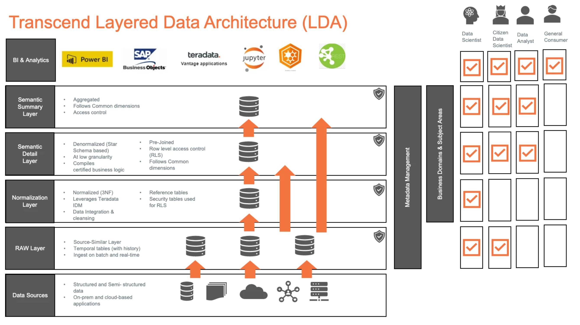
Layered Data Architecture

Slide 105
Existing reporting patterns using Transcend Business Objects – Part 1
To access the Transcend (IDW) data by both SQL and non-SQL users
Self-service business reporting
Users build their own report using the Transcend Business Objects (BO) universes
Users copy the public folder reports into favorites folder and alter the BO report to generate the data necessary for business reporting
Drill up option to summarize data from the existing BO reports
Push reporting using BO report data. Users create and share PDF or Excel reports with others on a defined schedule. Example: T&E Expense reports are generated and shared monthly as an email with different level of managers, including ELT.
Reconciliation reports, used to compare data between systems like comparing Salesforce Orders with ERP OM Orders.
Data from multiple Transcend BO universes sourcing data from systems like ERP, Workday, Salesforce, Financialforce, Callidus are merged to build BO reports. Example: Revenue by Customer (Accounts Receivables, GL, Workday data)
BO report data is exported and used along with data manually extracted from other systems like Workday
Notes:
Operational reports are formal documents or reports which provide the most granular level detail for business transactions and events.

Slide 106
Existing reporting patterns using Transcend Business Objects – Part 2
Operational reports like Aging invoices list, AR collections report, Open PO report.
Reconciliation BO reports are used during the month-end accounting close process.
Transcend BO reports are used for the accounting business process.
X1 sweep process: Revenue in one country or ERP customer needs to be recognized under different country or ERP customer for accounting and planning purposes.
Denied Party list report is used to compare the customers potentially in US gov banned list (legal compliance) and provide input to Legal and procurement team. Source for Transcend is Weekly file for Descartes MK Denial.
BO reports are used for sharing data with PWC for external audit, with Deloitte for IT audit and by internal audit teams.
Notes:
Operational reports are formal documents or reports which provide the most granular level detail for business transactions and events.

Slide 107
Transcend team's month/quarter end responsibilities
Ensure that month-end currency translation rates (from treasury) are loaded with no issue
Ensure that the last ERP transactional files (CFS, OM, AR, Inventory) are loaded successfully
Ensure that all month-end jobs are executed successfully and in the right order
Ensure that intraday and near real-time General Ledger (GL) loads are successful with no interruption during closing periods
Ensure that certain Workday jobs are completed without delay in certain key dates as there are other jobs waiting for it to complete first
Ensure that General Ledger (GL) data is transformed to add HFM dimensions and is available to pull into Hyperion Financial Management (HFM)
Ensure that the reconciliation BO reports are available for the month-end accounting close activities

Slide 108
Transcend Analytics Ecosystem
Powered by Vantage, Transcend is our internal enterprise analytics ecosystem (typically known as Enterprise Data Warehouse)
Sources/Targets
ETL
Enterprise Analytics Platform
Analytics Solutions
Enterprise Data Hub
Data Labs/ Sandboxes
Transcend Analytics Portal
Domain BI
PowerBI / BO
Semantic Layer
Telemetry
(Customer Systems)
Integration Layer
Streaming
SQL
Vantage Editor
Data Science
Jupyter – R/Python
Raw Layer
SaaS Providers
(Ex: Salesforce, SNOW, WDAY)
Batch
Governance and Security
Personal DB
Data Labs
On-Prem Services
(ERP)
On-Prem
Cloud
Notes:
Layered data architecture:
Raw Layer – source similar, first landing area for the data in Transcend
Integration – Core layer for enabling data warehousing best practices
Semantic - reporting layer where users can access modeled data
Self-service Analytics Prototyping environments:
1) Personal Database/Sandbox
All employees will have a personal database with the same name as your QLID will be available in both the environments: 1GB database on Transcend under their Quicklook ID (QLID)
Provide the ability for users to load experimental data into their Personal database and query them
2) DataLab: Transient environment for collaborative prototyping. You will need to request access to start using DataLabs.
Log an incident in Service Hub to be on-boarded to start using DataLabs. Begin the incident with “Transcend IDW MS Team-” and the support team will guide you.
Onboarding/Training/How-to byte size videos will be shared once you acknowledge Terms and Conditions

Slide 109
Layered Data Architecture

Slide 110
Existing reporting patterns using Transcend Business Objects – Part 1
To access the Transcend (IDW) data by both SQL and non-SQL users
Self-service business reporting
Users build their own report using the Transcend Business Objects (BO) universes
Users copy the public folder reports into favorites folder and alter the BO report to generate the data necessary for business reporting
Drill up option to summarize data from the existing BO reports
Push reporting using BO report data. Users create and share PDF or Excel reports with others on a defined schedule. Example: T&E Expense reports are generated and shared monthly as an email with different level of managers, including ELT.
Reconciliation reports, used to compare data between systems like comparing Salesforce Orders with ERP OM Orders.
Data from multiple Transcend BO universes sourcing data from systems like ERP, Workday, Salesforce, Financialforce, Callidus are merged to build BO reports. Example: Revenue by Customer (Accounts Receivables, GL, Workday data)
BO report data is exported and used along with data manually extracted from other systems like Workday
Notes:
Operational reports are formal documents or reports which provide the most granular level detail for business transactions and events.

Slide 111
Existing reporting patterns using Transcend Business Objects – Part 2
Operational reports like Aging invoices list, AR collections report, Open PO report.
Reconciliation BO reports are used during the month-end accounting close process.
Transcend BO reports are used for the accounting business process.
X1 sweep process: Revenue in one country or ERP customer needs to be recognized under different country or ERP customer for accounting and planning purposes.
Denied Party list report is used to compare the customers potentially in US gov banned list (legal compliance) and provide input to Legal and procurement team. Source for Transcend is Weekly file for Descartes MK Denial.
BO reports are used for sharing data with PWC for external audit, with Deloitte for IT audit and by internal audit teams.
Notes:
Operational reports are formal documents or reports which provide the most granular level detail for business transactions and events.

Slide 112
Transcend team's month/quarter end responsibilities
Ensure that month-end currency translation rates (from treasury) are loaded with no issue
Ensure that the last ERP transactional files (CFS, OM, AR, Inventory) are loaded successfully
Ensure that all month-end jobs are executed successfully and in the right order
Ensure that intraday and near real-time General Ledger (GL) loads are successful with no interruption during closing periods
Ensure that certain Workday jobs are completed without delay in certain key dates as there are other jobs waiting for it to complete first
Ensure that General Ledger (GL) data is transformed to add HFM dimensions and is available to pull into Hyperion Financial Management (HFM)
Ensure that the reconciliation BO reports are available for the month-end accounting close activities

